Slide 1
Non-rigid mapping for spatially-dense phenotyping and multivariate statistical analysis
Harold Matthews, Peter Claes
harry.matthews@kuleuven.be

Slide 2
Part One: What is non-rigid mapping and what is it for?

Slide 3
Meshmonk
Purpose: Non-rigid mapping for spatially-dense phenotyping.

Slide 4
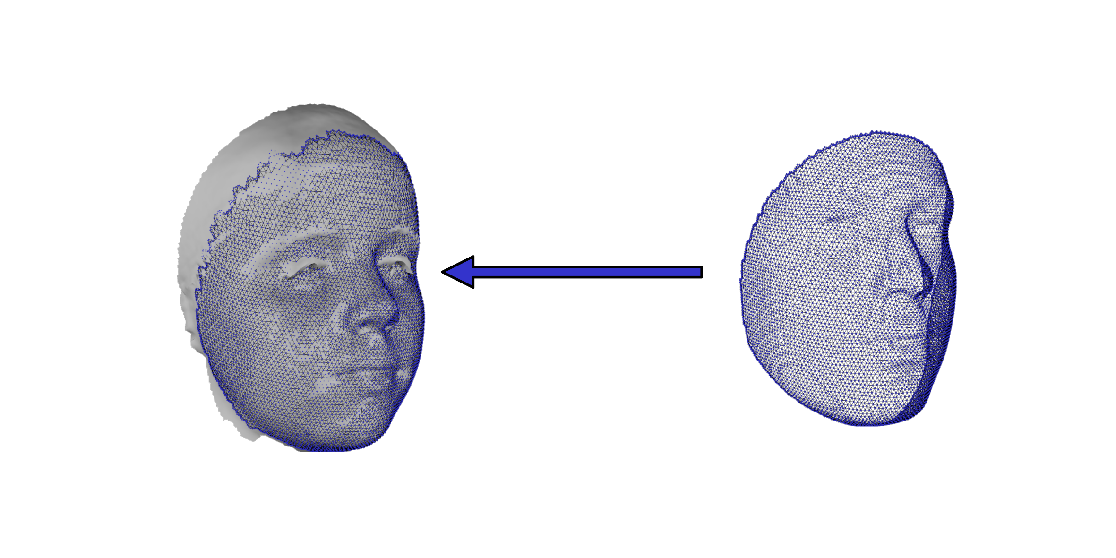
Meshmonk
Purpose: Non-rigid mapping for spatially-dense phenotyping.
Learn non-rigid mapping of a template ‘Floating’ shape into the shape of a ‘Target’ image while preserving the anatomical meaning of points.

Slide 5
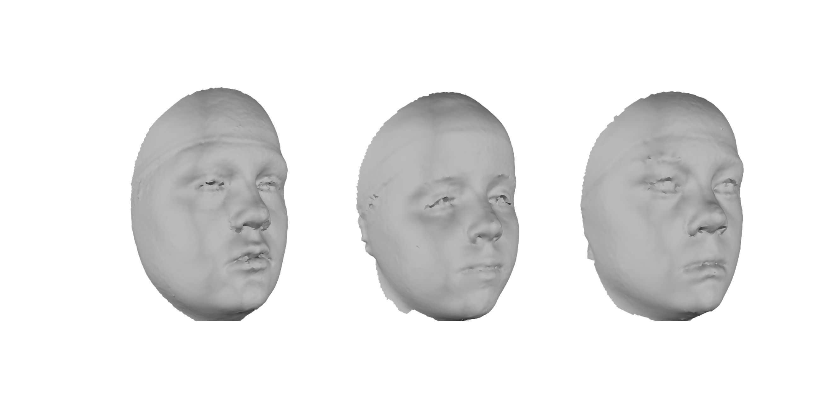
Spatially-dense phenotyping

Slide 6
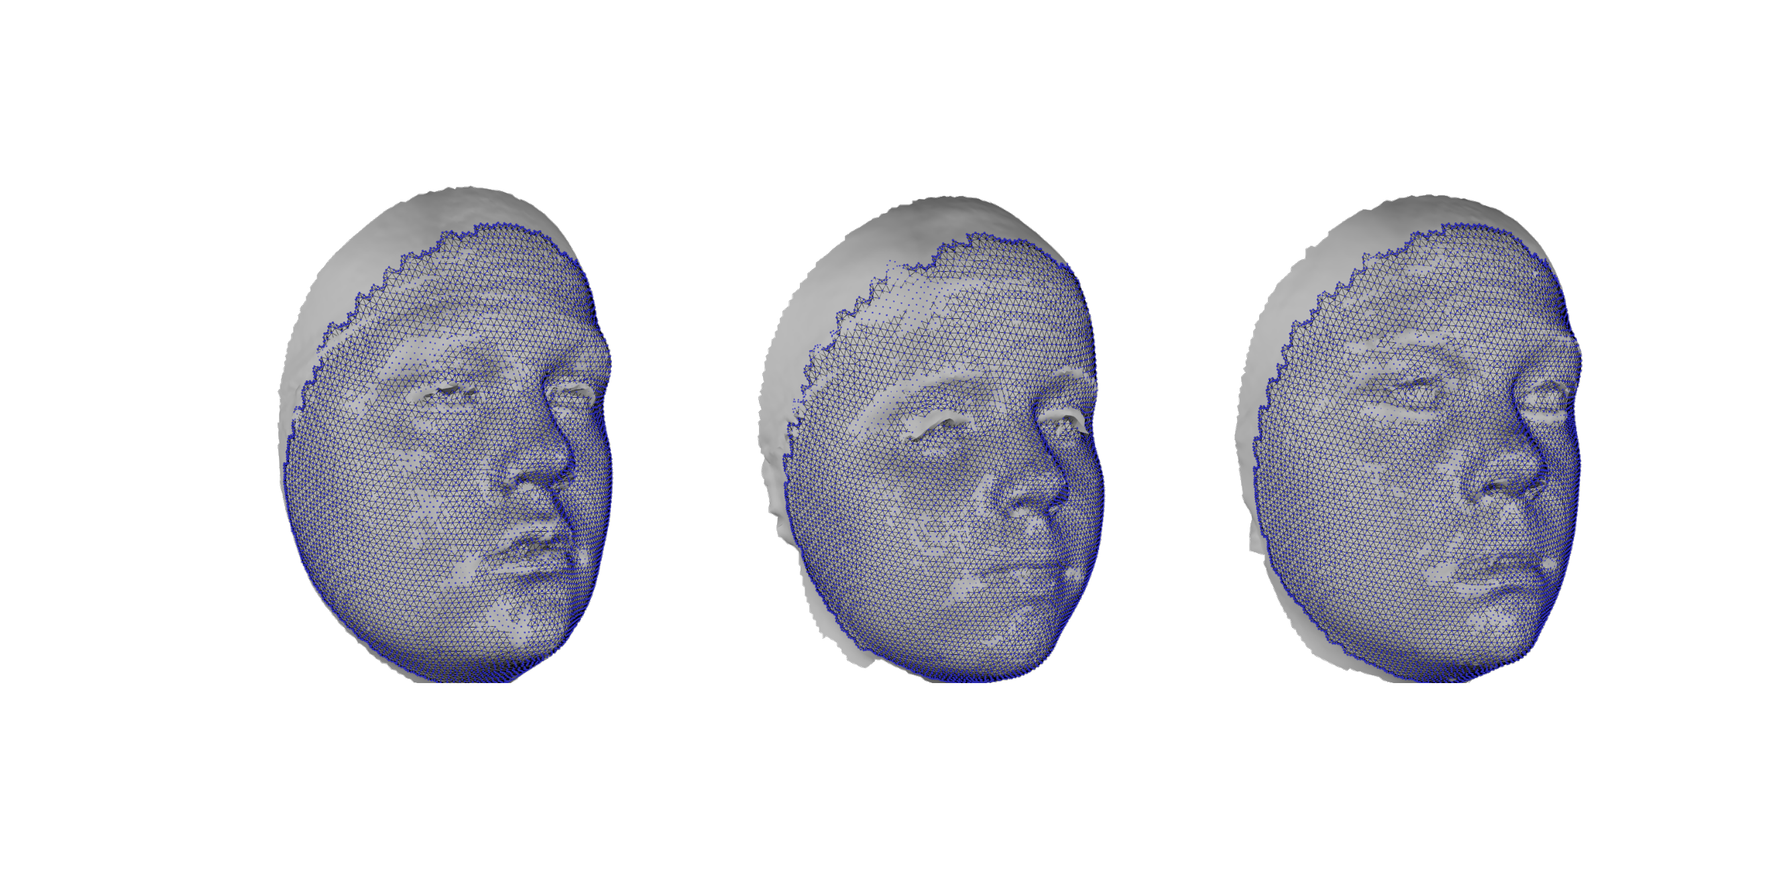
Spatially-dense phenotyping

Slide 7
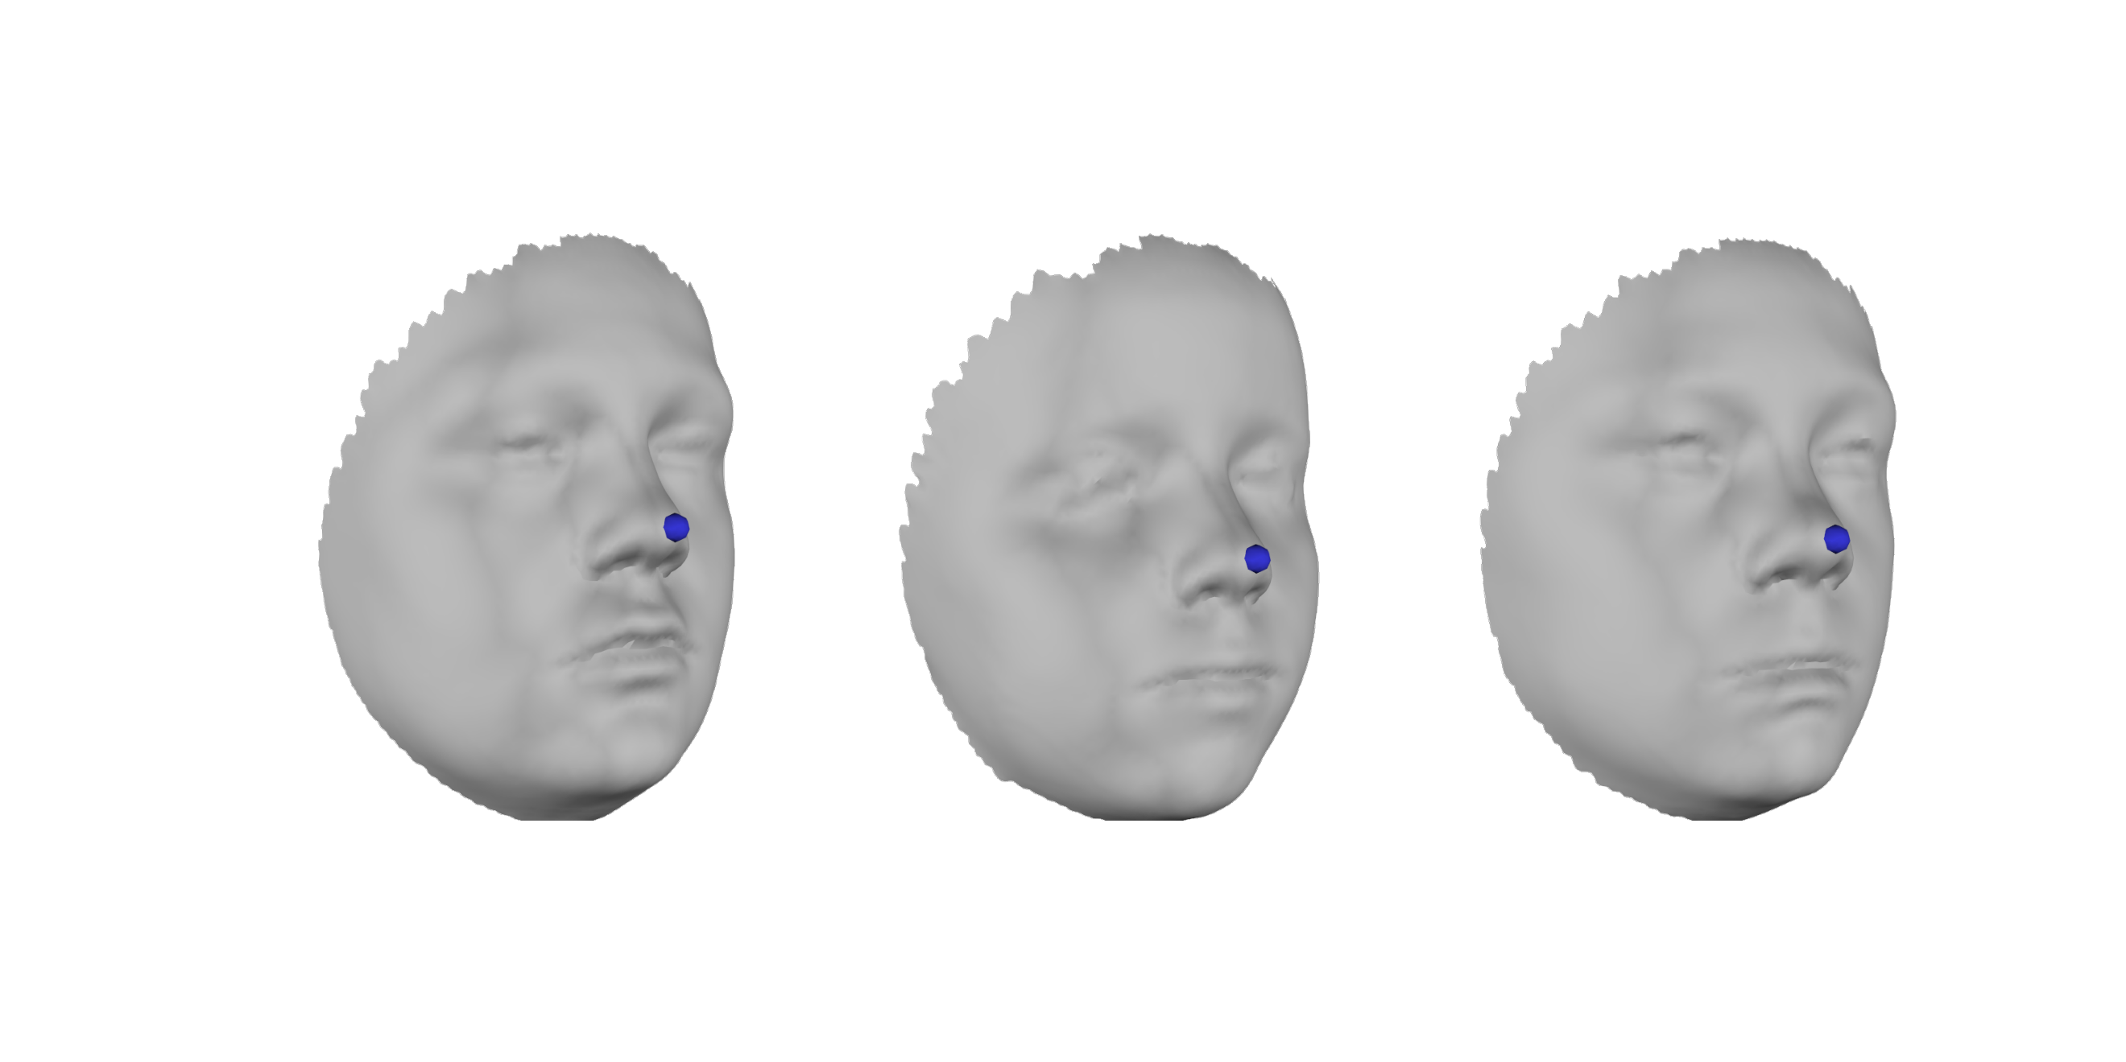
Preserving anatomical meaning of points
Vertex 4042

Slide 8
Meshmonk
Purpose: Non-rigid mapping for spatially-dense phenotyping.
Learn non-rigid mapping of a template ‘Floating’ shape into the shape of a ‘Target’ image while preserving the anatomical meaning of points.
Essentially resampling each Target
At 1000s of points. Because these
points correspond across the sample
they can be meaningfully combined
in multivariate statistical analyses.

Slide 9
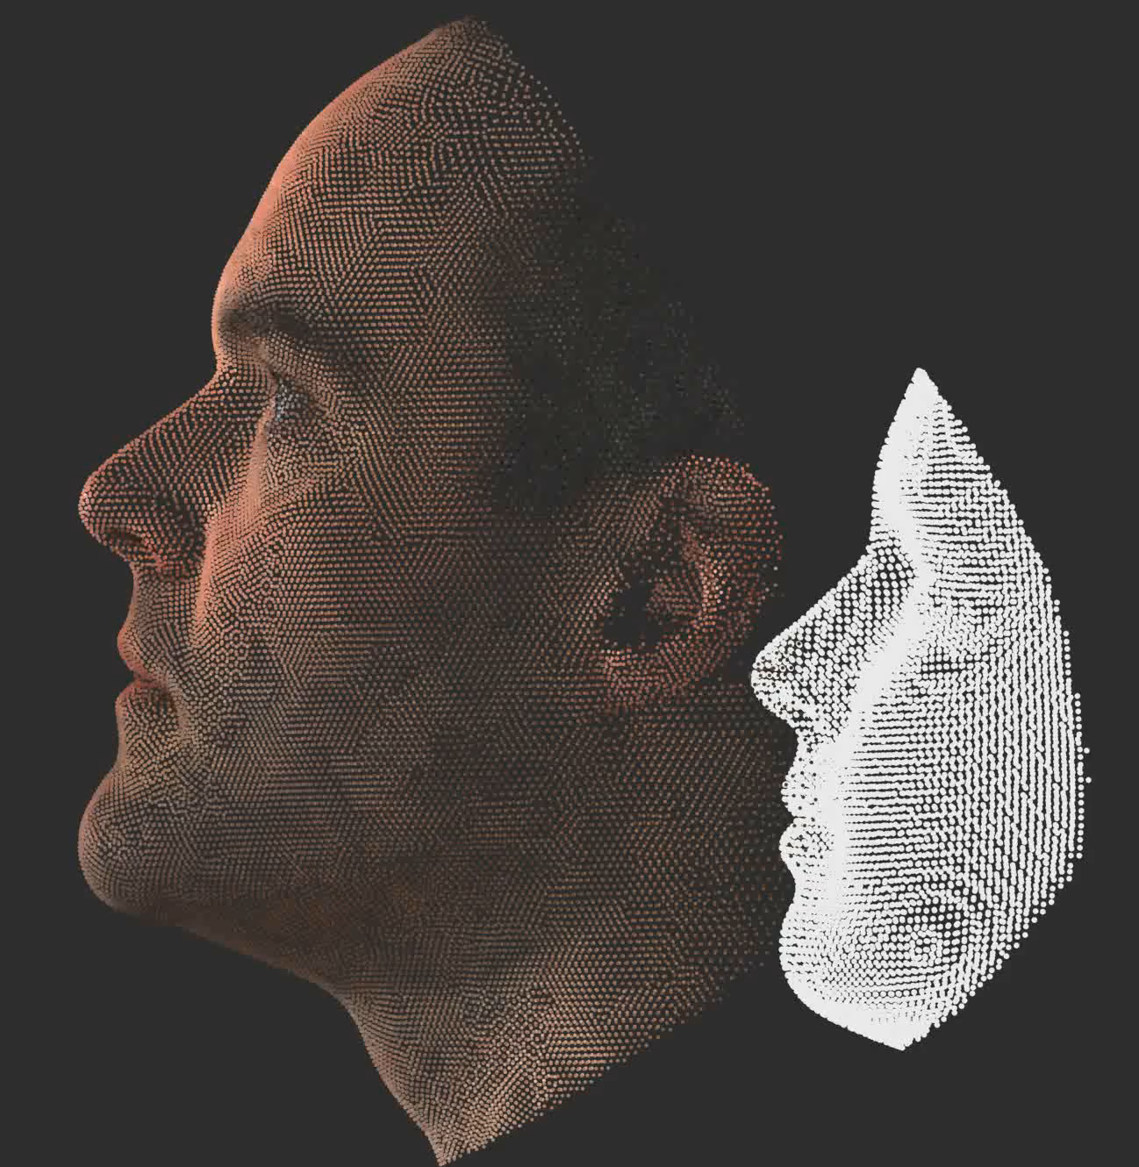
Meshmonk Pipeline
Rigid initialization based on landmarks
Rigid ICP
Non-parametric, non-rigid ICP

Slide 10
Meshmonk Pipeline
Rigid initialization based on landmarks
First two steps rigidly align the floating face to the target, to provide a good starting point to the third step.
Rigid ICP
Non-parametric, non-rigid ICP

Slide 11
Meshmonk Pipeline
Rigid initialization based on landmarks
Third step is the important bit.
Rigid ICP
Non-parametric, non-rigid ICP

Slide 12
Meshmonk toolbox description
Core MeshMonk
These are functions that handle the elements of the mapping pipeline. Implemented in C++. When these a ‘mexed’ they can be called from MATLAB.
Important ones are:
Compute_correspondences
Compute_inlier_weights
Compute_normals
Compute_rigid_transformation
Compute_nonrigid_transformation

Slide 13
Meshmonk toolbox description
MATLAB helper classes:
Shape3D – represents a surface as a ‘mesh’
Viewer – supports viewing and interacting with shape3D.
ShapeMapper – controls rigid or nonrigid mapping and interfaces with the core meshmonk functions so that, as an end user, you do not need to interact with them directly.
We will not necessarily be able to maintain the viewer class (there are already some issues with using on mac in MATLAB 2018). However, all functionality is available (MATLAB 2014-2017). This tutorial should work for all versions 2014-2019.
Be aware of other software that supports mesh visualization:
MeshLab
Blender
R: https://rdrr.io/rforge/rgl/man/mesh3d.html; https://github.com/geomorphR/geomorph; https://github.com/Arslan-Zaidi/Facial_masculinity_MHC/tree/master/Tutorial_visualizing_facial_heatmaps;
Python Mayavi library and GUI: https://docs.enthought.com/mayavi/mayavi/auto/mlab_helper_functions.html#mayavi.mlab.triangular_mesh

Slide 14
Part Two: Tutorial – Understanding non-rigid mapping with MeshMonk

Slide 15
Practicalities
Have MATLAB and Meshmonk installed.
Otherwise you will need to pair up with someone who has it installed.
Meshmonk installation instructions: https://github.com/TheWebMonks/meshmonk
Have Meshmonk ‘matlab’ folder on your machine.
Open ‘UnderstandingNonRigidMappingWithMeshmonk.m’

Slide 16
Practicalities
At the start of the script change ’tutorialPath’ to wherever the tutorial folder is on your machine.
Change the path in the line ‘addpath(genpath(path))’ to wherever meshmonk/matlab is on your machine.
Run the first cell:
‘run section and advance’ in the ‘Editor’ tab

Slide 17
Exercise 1: Visualize components of a mesh
In this exercise we explore components of a mesh, how they are represented in a Shape3D class, and how to visualize them with the Viewer.
Run the cell:
load an .obj wavefront as a Shape3D.
This creates a variable ‘obj’ that is an instance of the Shape3D class and represents the mesh.
Enter ‘obj’ in the MATLAB console and look at its attributes.
To look at specific attributes e.g. the vertices of the mesh, type obj.Vertices

Slide 18
Exercise 1: Visualize components of a mesh
There are attributes of Shape3D that control how it will be shown in the viewer. The next three cells demonstrate different ways of viewing a mesh
Run the cells:
visualise vertices using Viewer
visualise the triangulated surface
visualise the smooth surface

Slide 19
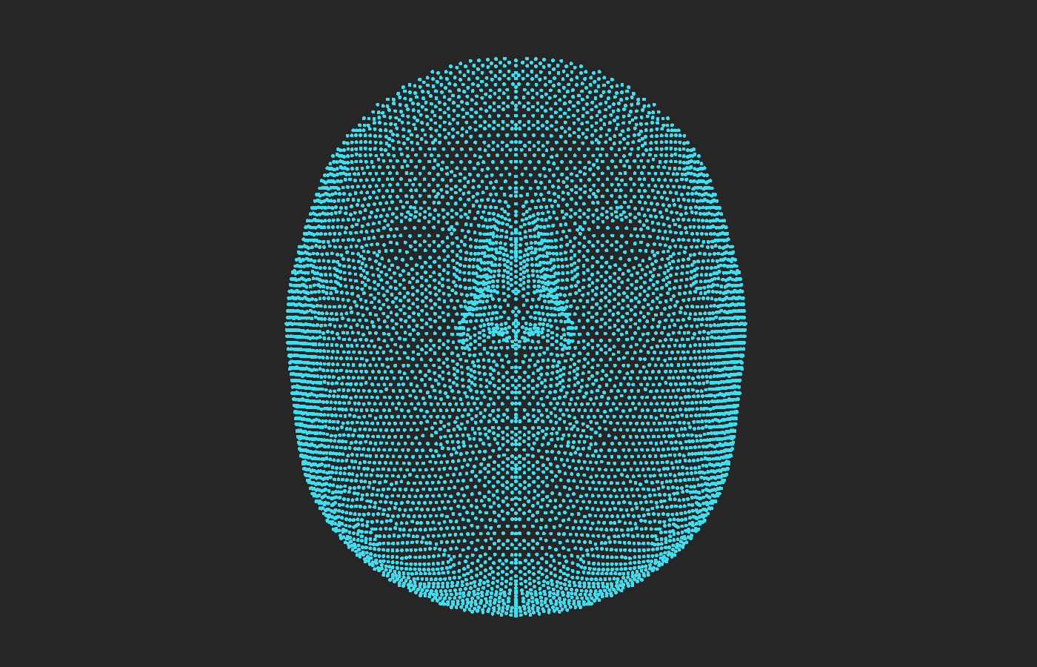
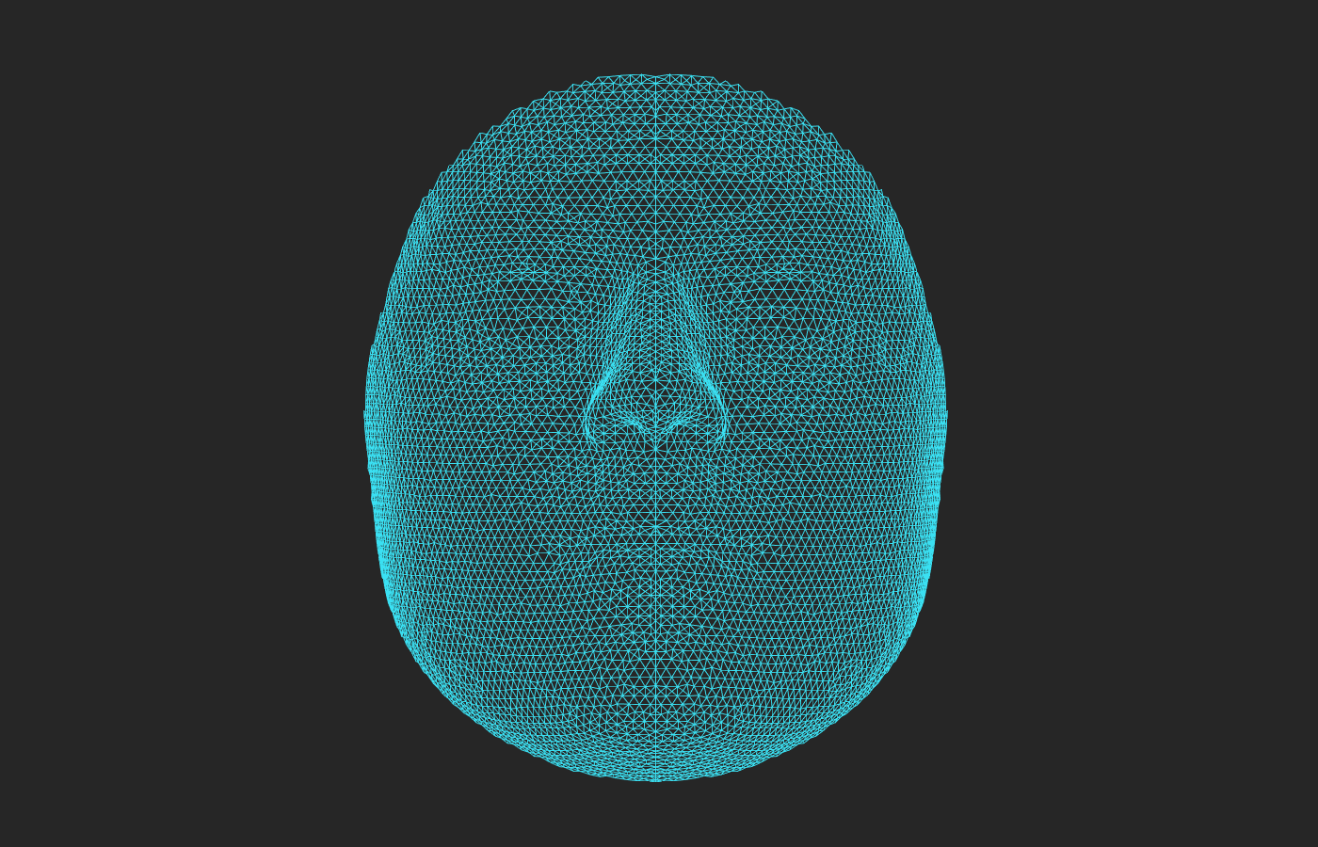
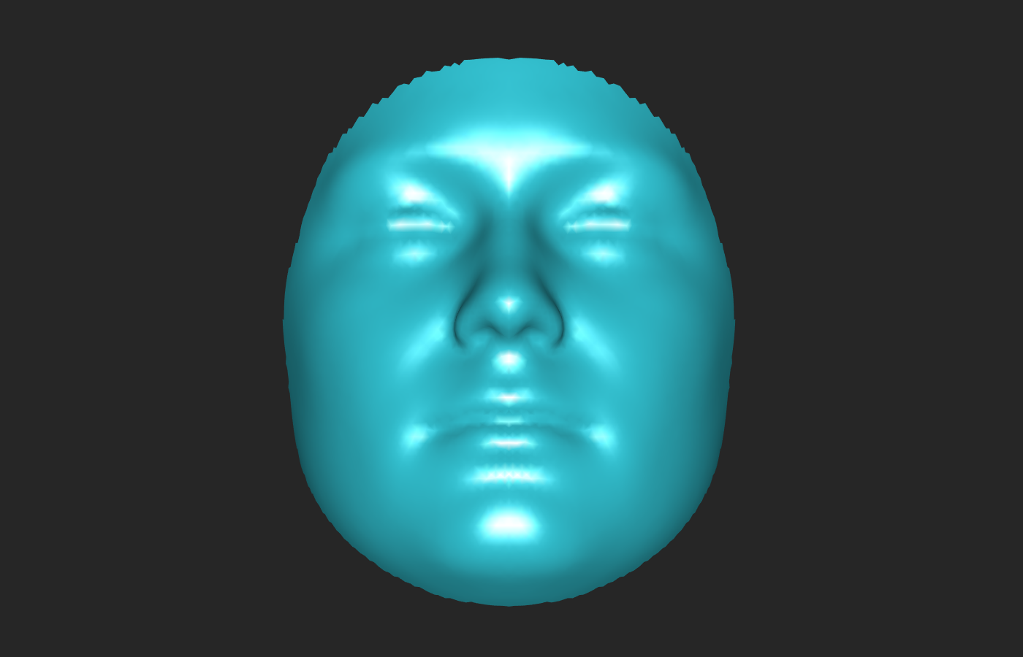
Exercise 1: Visualize components of a mesh
obj.ViewMode=‘points’
obj.ViewMode=‘wireframe’
obj.ViewMode=‘solid’

Slide 20
Exercise 1: Visualize components of a mesh
Meshmonk makes use of point co-ordinates and ‘surface normals’ to execute the mapping. These are the directions perpendicular to the triangulated surface at each point. They convey information about the local orientation of the surface.
Run the cell:
‘Visualise the surface normals’

Slide 21
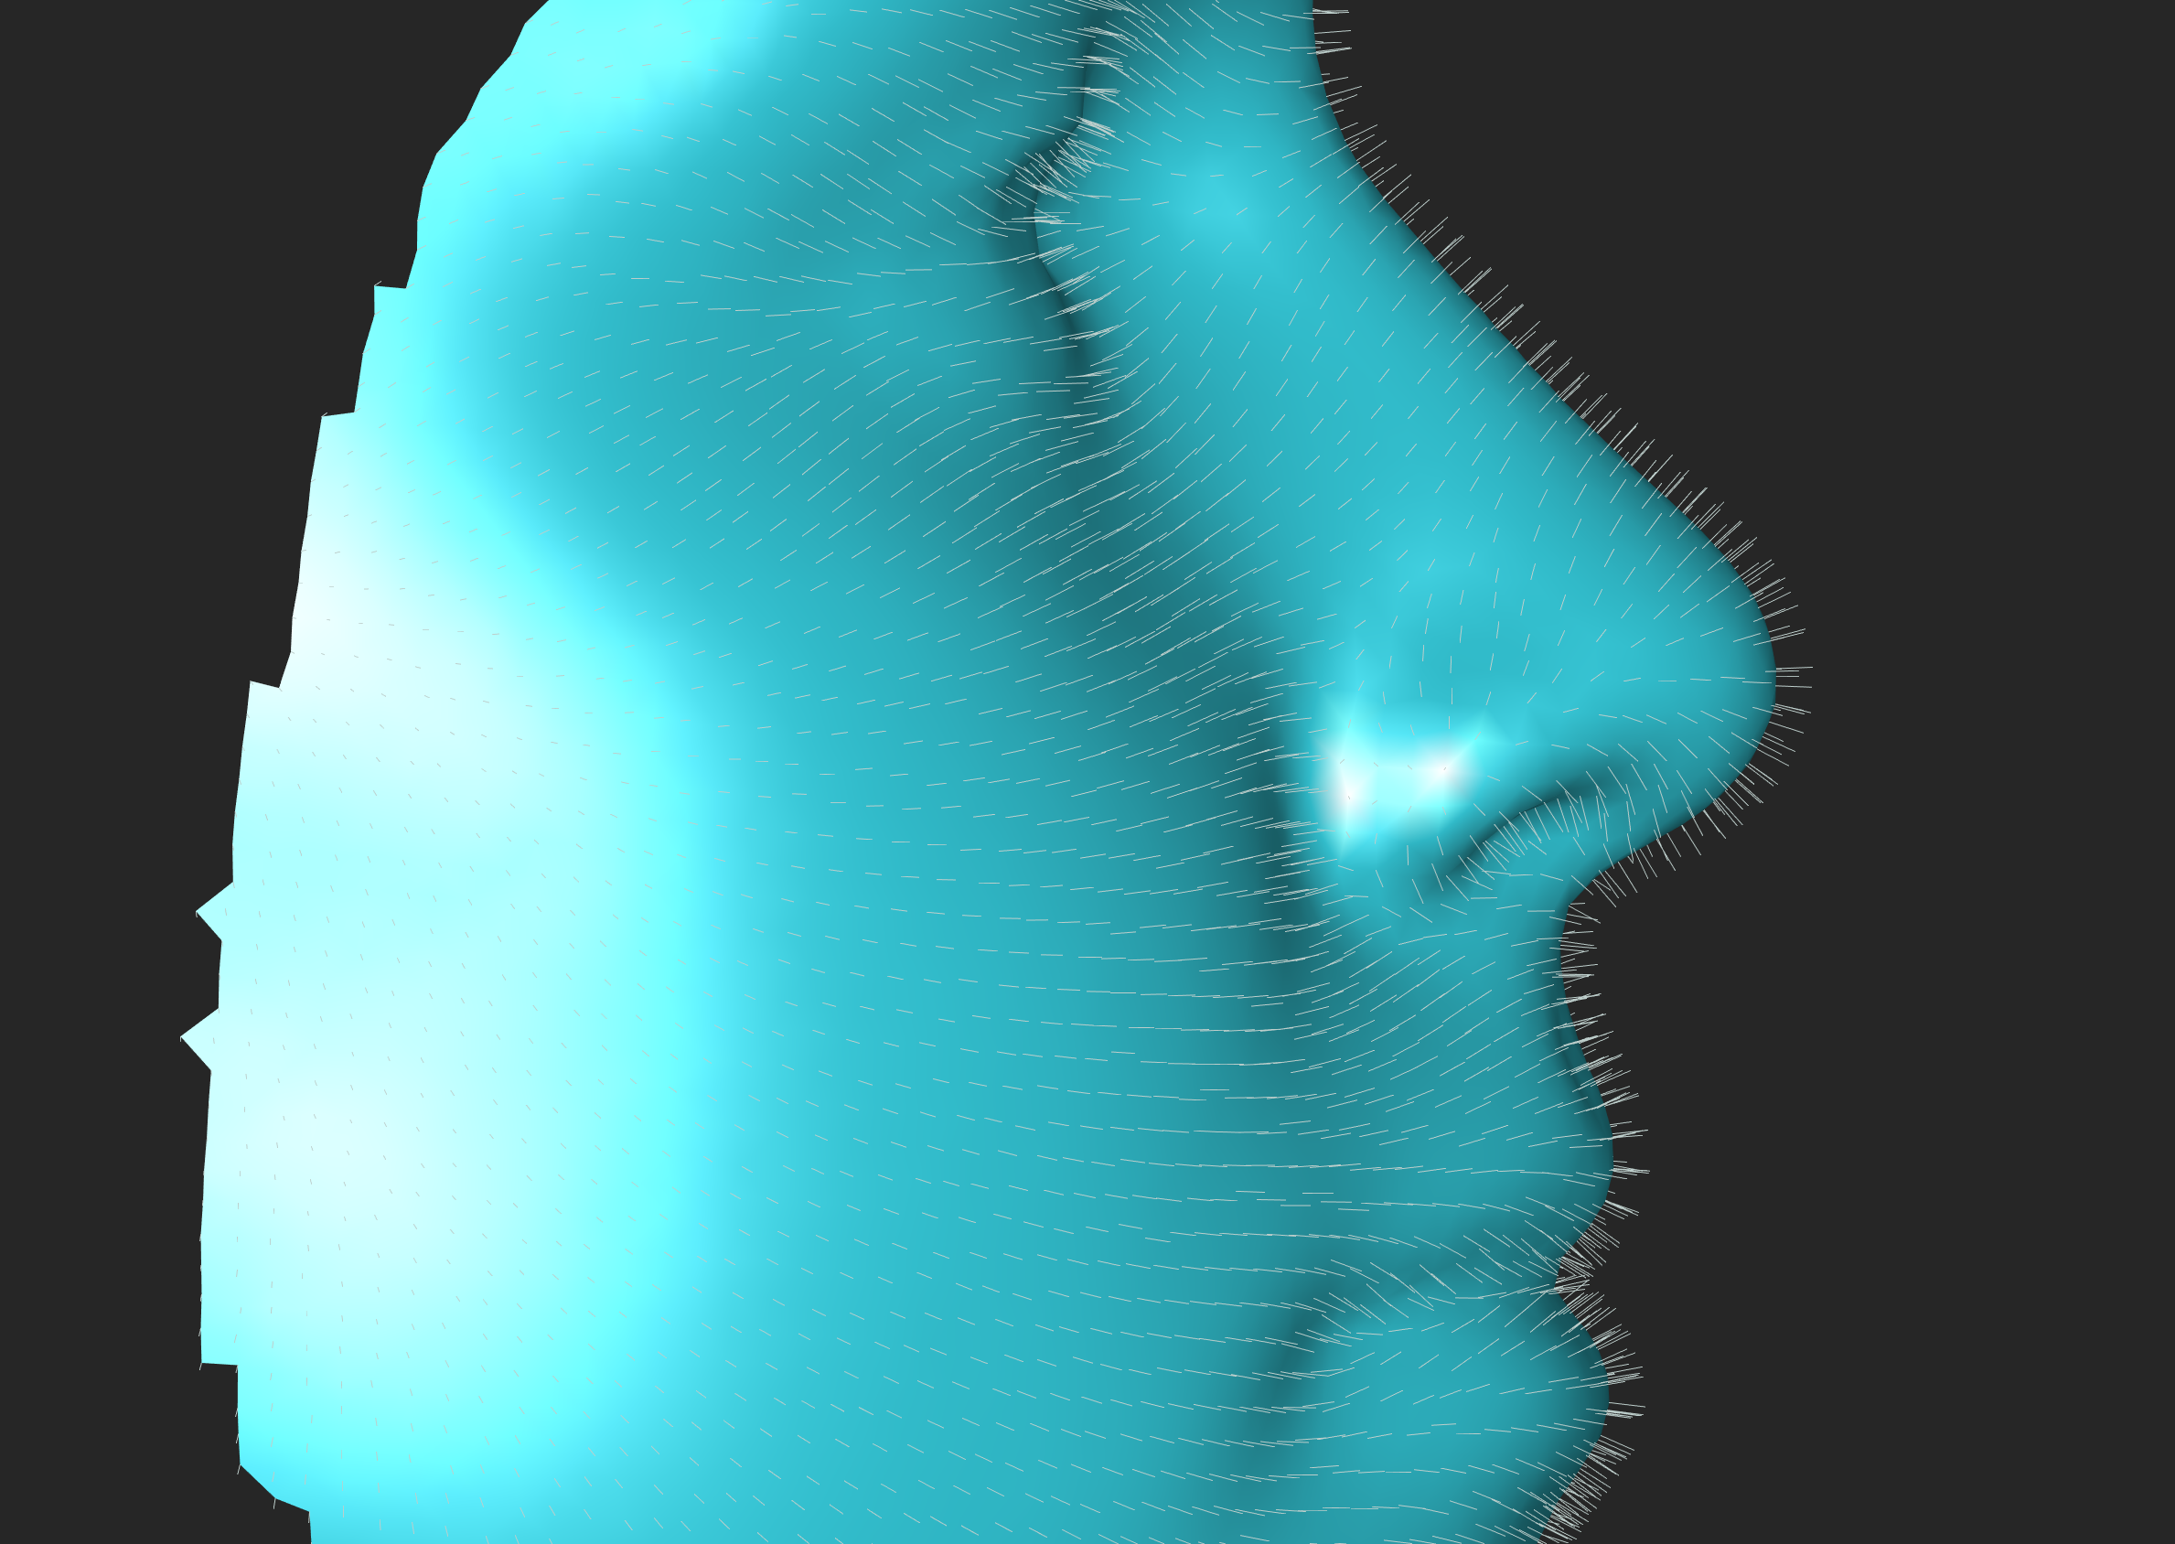
Exercise 1: Visualize components of a mesh

Slide 22
Exercise 2: A single iteration of non-rigid ICP
Non-rigid mapping is accomplished iteratively. We will now explore what occurs in a single iteration. We will address how this changes in multiple iterations in the next exercise.
To illustrate this we use some of the core meshmonk functions ‘compute_correspondences’ and ‘compute_nonrigid_transformation’. In practice you will not need to use these directly.

Slide 23
Exercise 2: A single iteration of non-rigid ICP
First we need an estimate how the points on the Floating image need to be deformed so as to be in the shape of the target.
Estimate corresponding points as the mean of the n ‘closest’ points.
Closeness is defined in terms of spatial proximity and similarity of surface normal.
Run the cells:
load Floating and Target Meshes
Step 1 - compute correspondences

Slide 24
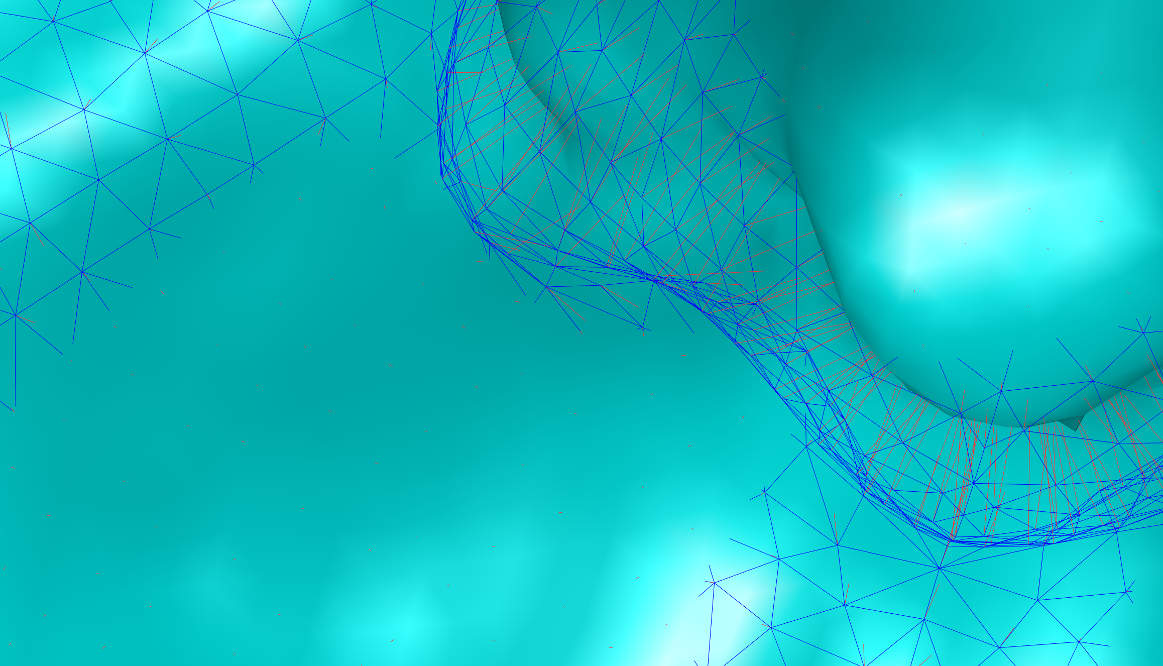
Exercise 2: A single iteration of non-rigid ICP
It is a bit difficult to see, but in the window is plotted vectors (in red) from each point on the Floating face (blue wireframe) to its estimated corresponding points on the Target

Slide 25
Exercise 2: A single iteration of non-rigid ICP
This provides an initial (but not particularly good) estimate of how the floating face should be deformed. To illustrate that it is not very good we will apply this deformation directly onto the Floating face and see what happens.
Run the cell:
See what happens if you apply the initial estimate directly

Slide 26
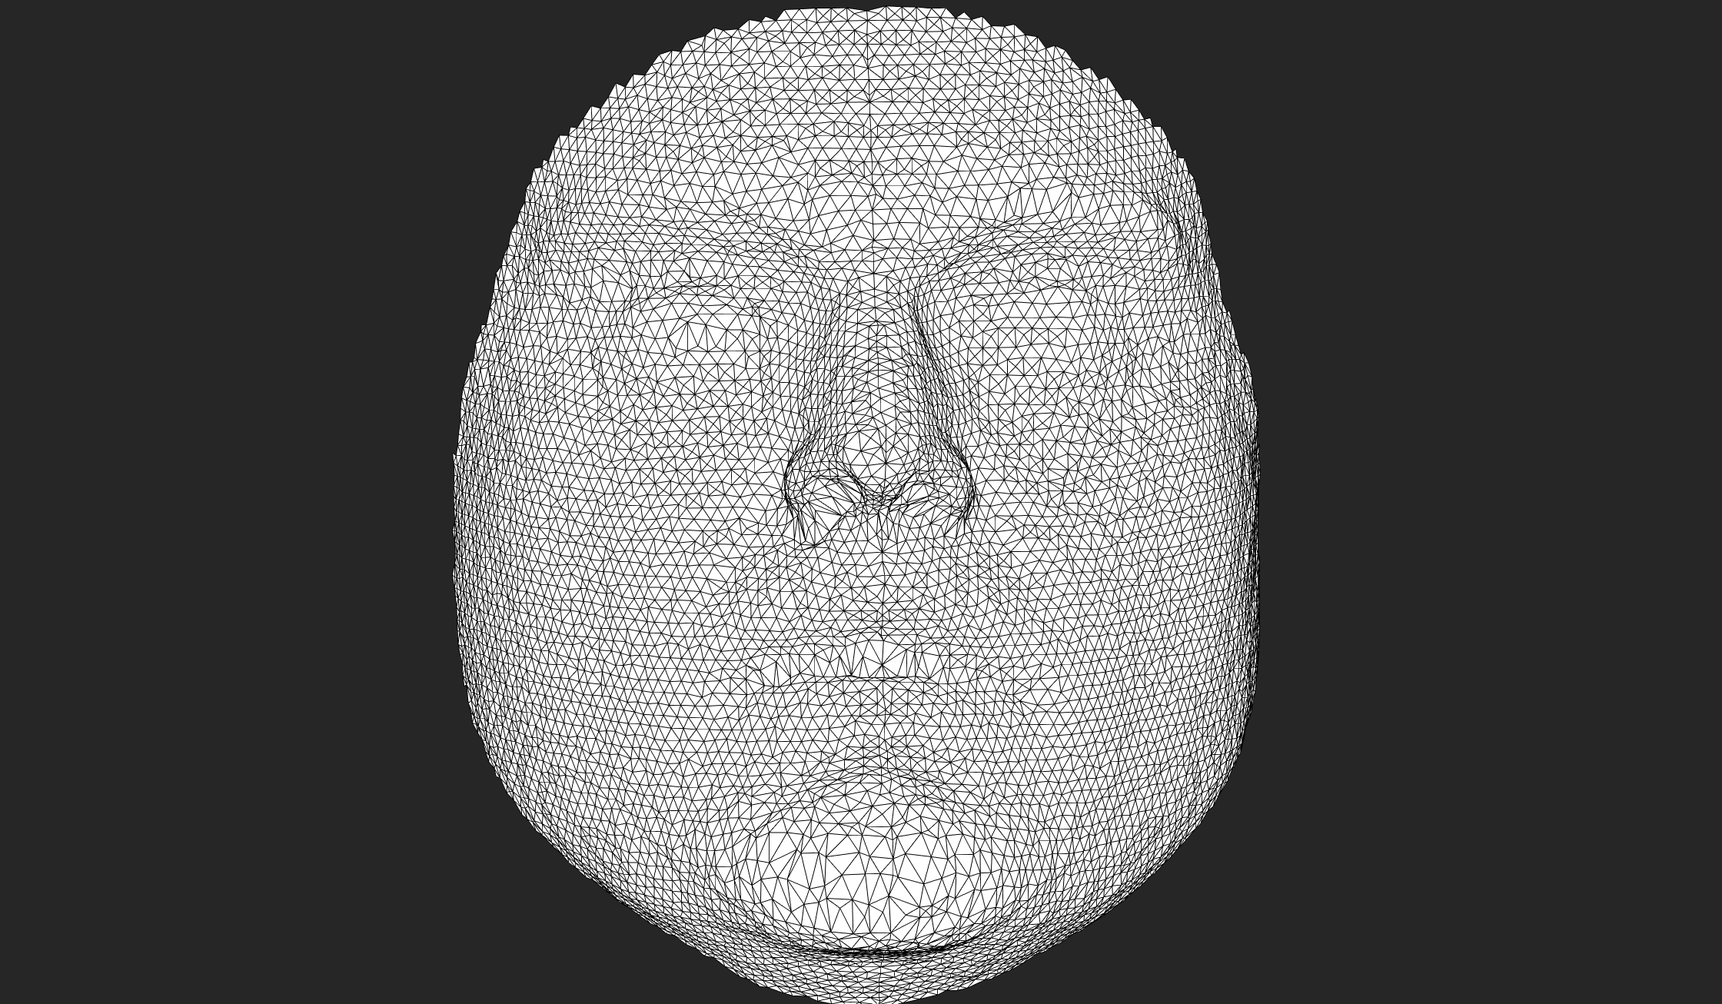
Exercise 2: A single iteration of non-rigid ICP
Points of the Floating face that were initially regularly spaced are haphazardly displaced. Indicating the anatomical meaning is not likely to have been well preserved.

Slide 27
Exercise 2
So within each iteration of MeshMonk this initial deformation field is smoothed/regularized. This is accomplished by convolving the deformation field with a Gaussian ‘x’ number of times.
To complicate things a bit there are actually two types of smoothing applied. These are equivalent while we are only performing one iteration so we won’t talk about the difference yet.
This smoothing is implemented in the ‘compute_nonrigid_transformation’ function and is controlled primarily by two parameters which control how many times to convolve with the Gaussian (‘x’). These two parameters correspond to the two different kinds of smoothing:
numViscousIterations
numElasticIterations

Slide 28
Exercise 2: A single iteration of non-rigid ICP
Play with the two regularization settings and run the cell:
Step 2 - Regularize deformation field.
E.g. try setting both parameters to 100, 5 and 0 and see how this affects how the deformation goes.

Slide 29
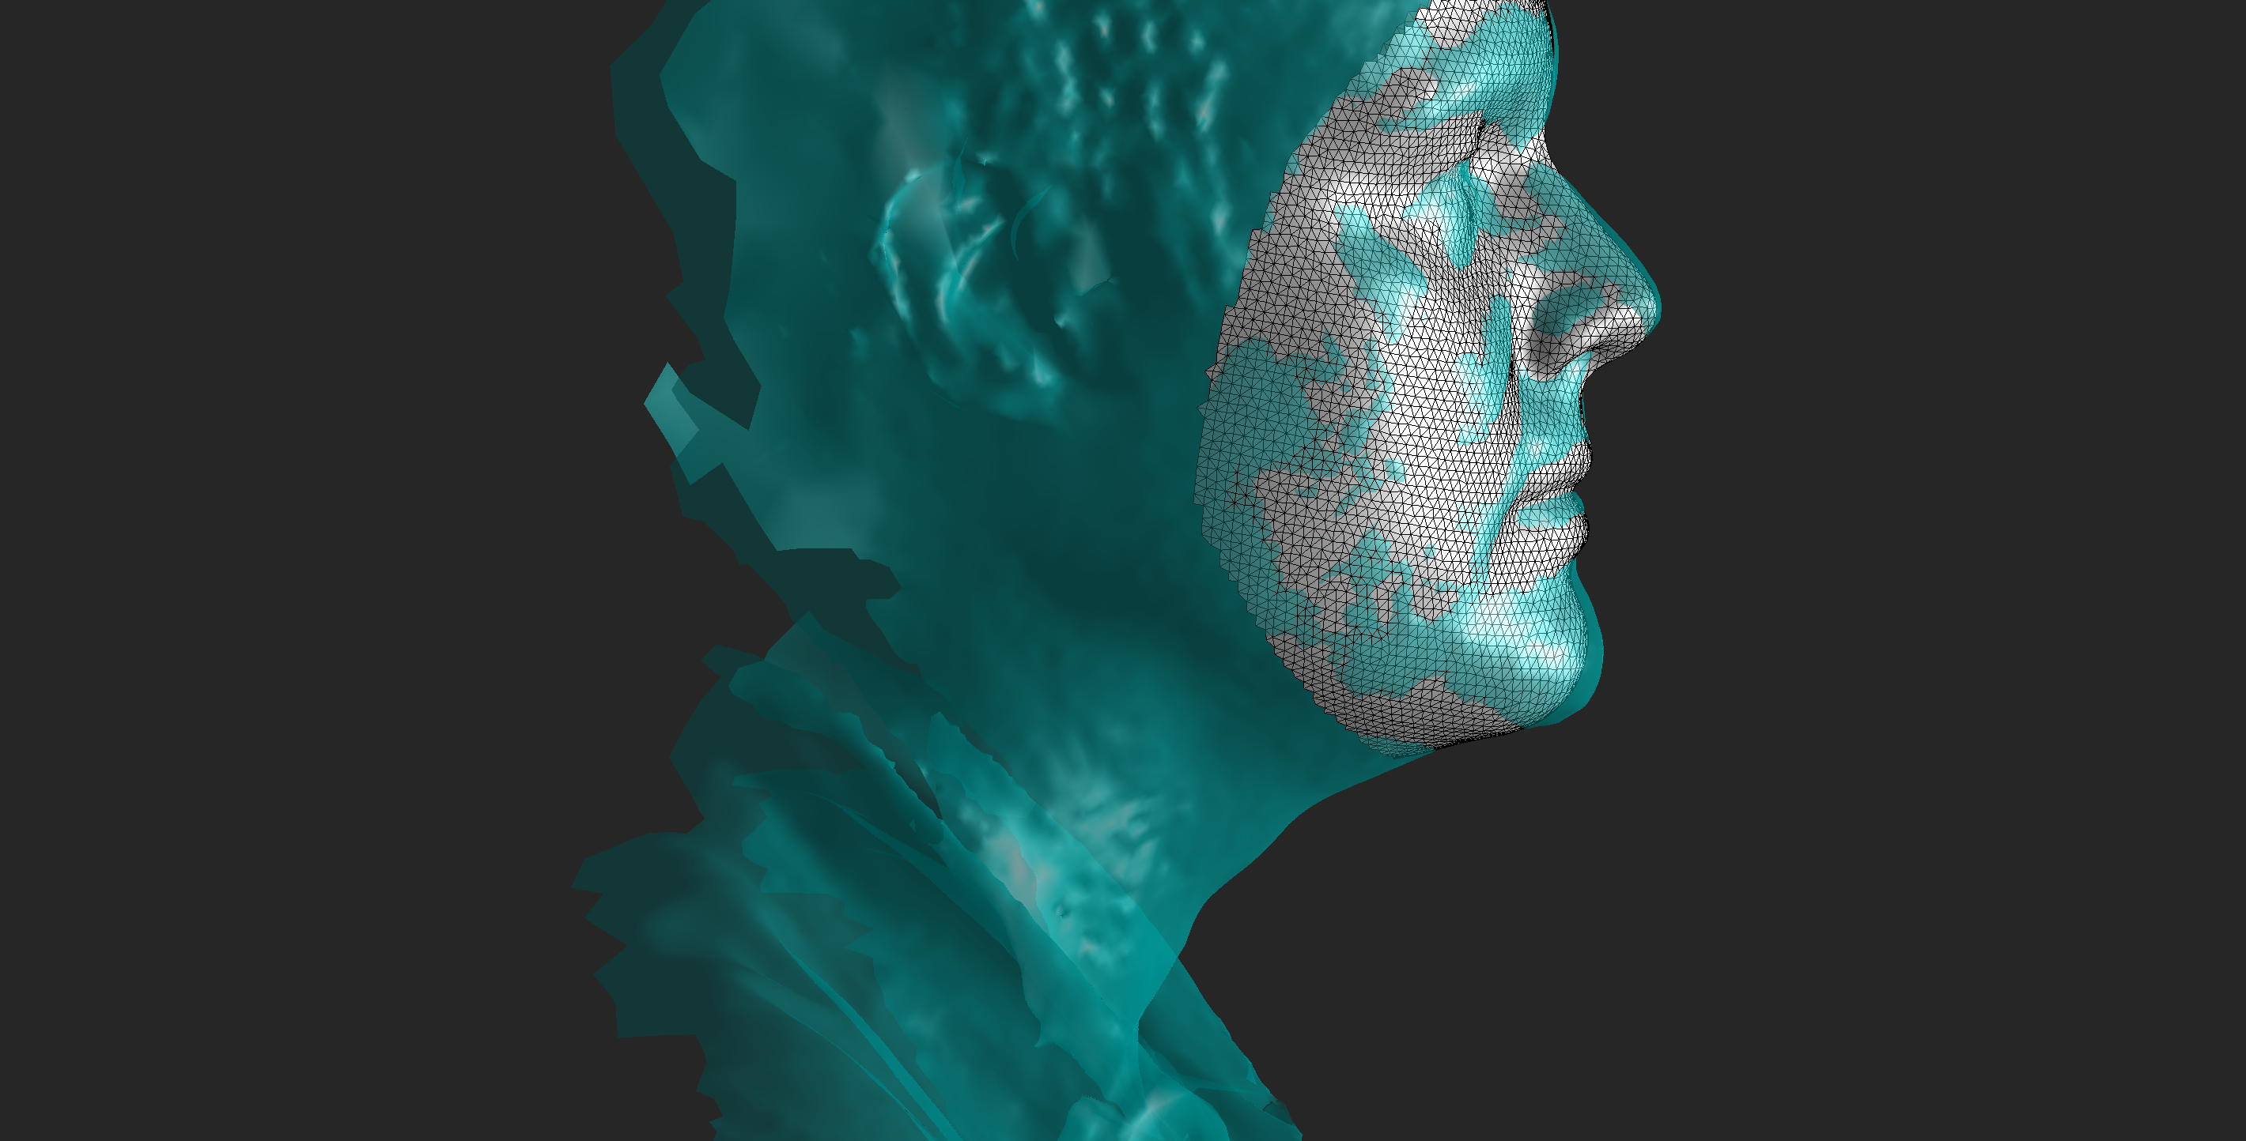
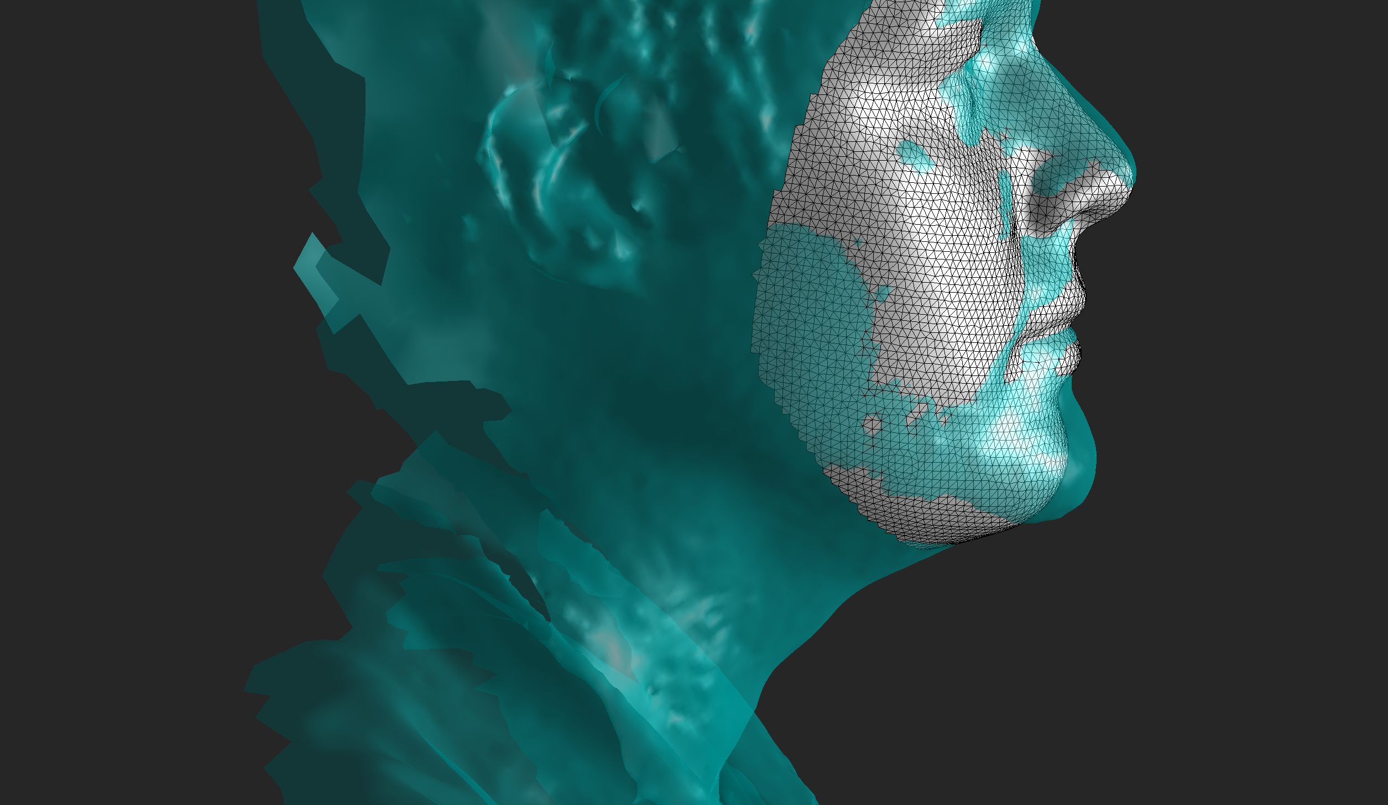
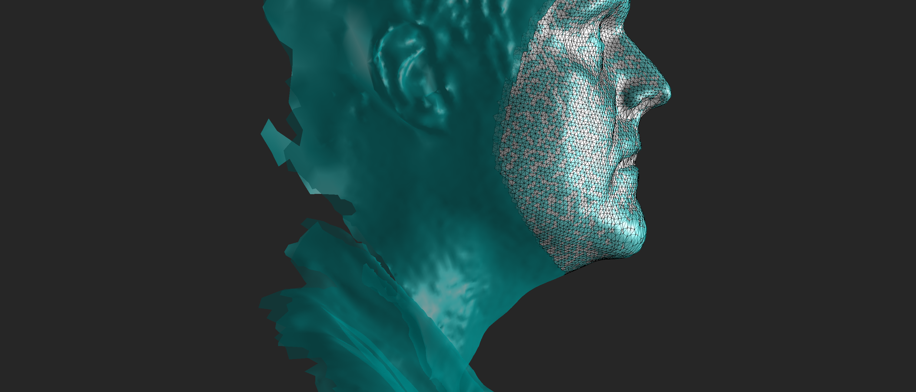
Exercise 2: A single iteration of non-rigid ICP
100
5
0

Slide 30
Exercise 3: Deterministic Annealing
A single Iteration of meshmonk:
Initial estimate of deformation (correspondences) -> convolve deformation field with Gaussian x times -> apply it to the floating mesh.
Too much regularization and the mesh will not match target, too little and the mesh deforms haphazardly (because correspondences are bad).
This impasse is overcome by accomplishing the mapping in multiple iterations. They key is to let the mesh deform gradually over multiple iterations. As the mesh gets closer to the target the correspondences get better and amount of regularization can be reduced, bringing the mesh yet closer to the target.

Slide 31
Exercise 3: Deterministic Annealing
Regularised deformation of template towards closest points
Reduce regularisation
Calculate ‘Closest’ points on target to template

Slide 32
Exercise 3: Deterministic Annealing
Regularised deformation of template towards closest points
Deterministic
Reduce regularisation
Calculate ‘Closest’ points on target to template

Slide 33
Exercise 3: Deterministic Annealing
Recall regularization in one iteration is controlled by:
numViscousIterations
numElasticIterations
Within the iterative framework the value of these on any given iteration of the algorithm is a function of user-specified starting and ending values and the user-specified total number of iterations of the algorithm.
I.e. it is completely determined by the settings given by the user.

Slide 34
Exercise 3: Deterministic Annealing
Run the cell:
plot deterministic annealing
This calculates how the number of viscous smoothing iterations is reduced from 200 to 1 over successive iterations.
Change ’numViscousIterationsStart’, ‘numViscousIterationsEnd’ and ‘numIterations’ and observe the effect on the plot.

Slide 35
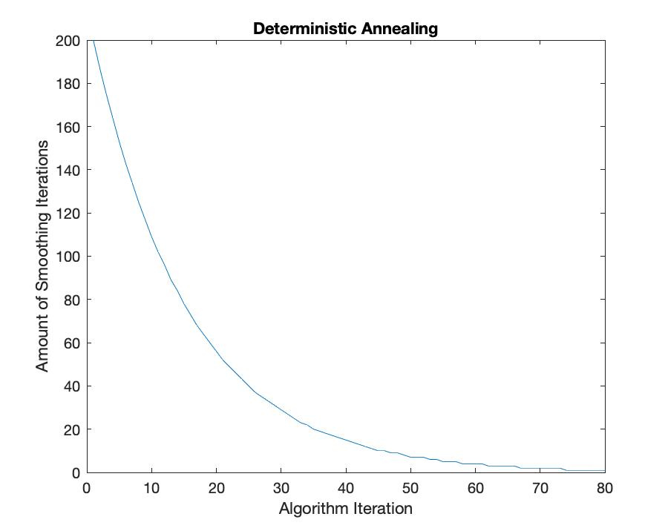
Exercise 3: Deterministic Annealing

Slide 36
Exercise 3: Deterministic Annealing
Within the iterative framework there is a difference between Viscous and Elastic smoothing.
’Viscous smoothing’ refers to smoothing of the deformation field from the deformed floating face output from the previous iteration.
‘Elastic smoothing’ refers to smoothing the deformation field from the original position of the floating face at iteration 1.
So actually two deformation fields are estimated and combined.
In both cases the amount of regularization is reduced as a function of starting and ending values and the number of iterations.

Slide 37
Exercise 4: Shape Mapper
The iterative framework implemented in the core MeshMonk functions is wrapped in the MATLAB ‘ShapeMapper’ class. This interfaces with the core meshmonk functions and controls the deterministic annealing. It gives the user access to all the settings that may need to be manipulated.
Run the cell:
Create shape mapper and map shape

Slide 38
Part Three: Tutorial – Batch processing images with MeshMonk

Slide 39
Preparing your images
We will not take you through this process in this tutorial, but we give some general information.
Images should be cropped and roughly landmarked. This is not supported (for all MATLAB versions) by the viewer class and the functionality will not necessarily be maintained so it is worth considering other options for how to do this.
Images can be cropped in MeshLab:
https://vimeo.com/98524579
Landmarking can be done in GeoMorph
https://www.youtube.com/watch?v=4S8XcMMgUyw

Slide 40
Preparing your images
Get your meshes in .obj format and your landmarks in a some kind of delimited text file (e.g. .csv or .txt).
Arrange these in two separate folders (the script assumes they are called ‘Targets’ and ‘Landmarks’). For each Target image (e.g. Mesh1.obj) there must be a corresponding Landmark file (e.g. Mesh1.csv)
We provide a generic function for reading landmarks: readTextLandmarkFile that takes the following settings that can probably be adjusted to read any format that is essentially a delimited text file.
Filename,
file delimiter character,
Column at which the landmark entries start
Column at which the landmark entries end
Row at which the landmark entries start
Row at which the landmark entries end

Slide 41
Practicalities
Open ‘BatchProcessingWithMeshmonk.m’

Slide 42
Cell 1: Set up Paths
This tells MATLAB where to look for the Target image and landmark files and where to save the results.

Slide 43
Cell 2: Set up Shape Mappers
This cell constructs two ShapeMappers. One that will handle the Rigid ICP step, another that will handle the Non-Rigid ICP step.
Whether the transformation is rigid or non-rigid is determined by the ShapeMapper setting ‘TransformationType’

Slide 44
Cell 3: Batch Process Files
This cell addresses how to process files in batch.
First each target file and landmark file is loaded
The landmarks on the target and floating face are used to estimate a first rigid alignment of the floating to the target.
There is a rough check of whether the normals of the floating and target both point inwards/outwards (if one set points inwards and one set points outwards this can cause many problems).
Executes Rigid ICP
Executes Non Rigid ICP
Saves the result.

Slide 45
Part Four: ShapeMapper Settings

Slide 46
Settings
In this section is first a description of all the settings of the ShapeMapper and what they do. I will not go through all of them in the interests of time but they are here for your reference.
Then I will talk a little about the most important settings and how they should be set.

Slide 47
Settings
ShapeMapper.TransformationType = [‘rigid’,’nonrigid’] controls whether to perform rigid (step 2) or nonrigid (step 3) mapping

Slide 48
Settings
Settings controlling finding correspondences:
ShapeMapper.CorrespondencesSymmetric = [true,false]; if true correspondences are estimated from the template to target and target to template and combined - this can help with mapping structures such as long bones and allows the target to 'pull' the template.
ShapeMapper.CorrespondencesNumNeighbours = [integer; 1<=x] number of neighbours to use to estimate correspondences
ShapeMapper.CorrespondencesUseOrientation = [true, false] whether to use the surface normal direction to estimate correspondences
ShapeMapper.CorrespondencesEqualizePushPull = [true, false] if CorrespondencesSymmetric is true then this will equalize the influence of both floating-target and target-floating correspondences.

Slide 49
Settings
Settings controlling which points should be assigned more or less weight in calculating the transformation. (outlier detection and flagging)
ShapeMapper.InlierKappa = [0<x] if the point is extreme within the distribution of differences between points of the floating and target face it will be downweighted. This setting is z-score determining how extreme this difference must be.
ShapeMapper.InlierUseOrientation = [true,false] whether to use similarity of surface normal direction is determining the 'difference’ (see above) between points on the floating and target shapes. If false the difference swill just be the distances between corresponding points.
ShapeMapper.FlagFloatingBoundary = [true,false] whether to ignore points that correspond to a point on the edge of the floating face
ShapeMapper.FlagTargetBoundary = [true, false] whether to ignore points that correspond to a point on the edge of the target face
ShapeMapper.FlagTargetBadlySizedTriangles = [true,false] whether to ignore points that correspond to a point belonging to a triangle that is unusual in the context of the given mesh
ShapeMapper.TriangleSizeZscore = [0<x]; how unusual does the triangle (see above) have to be
ShapeMapper.CorrespondencesFlagThreshold = [0<=x<=1]; for development purpose only. Leave as default.

Slide 50
Settings
Settings controlling regularization of the deformation field and deterministic annealing.
ShapeMapper.NumIterations = [integer; 1<=x] number of iterations of the algorithm
ShapeMapper.TransformSigma = [float; 0<x]; the width of the Gaussian with which to convolve the deformation field
ShapeMapper.TransformNumNeighbors = [integer; 2<=x] for efficiency, when convolving with the Gaussian not all deformation vectors are incorporated into the weighted average; it will only average the n closest neighbours. This setting sets the value of n
ShapeMapper.TransformNumViscousIterationsStart = [integer; 0<x] number of iterations of viscous smoothing applied during iteration 1
ShapeMapper.TransformNumViscousIterationsEnd = [integer; 0<x] number of iterations of viscous smoothing applied during the final iteration.
ShapeMapper.TransformNumElasticIterationsStart = [integer; 0<x] number of iterations of elastic smoothing applied during iteration 1
ShapeMapper.TransformNumElasticIterationsEnd = [integer; 0<x] number of iterations of elastic smoothing applied on the final iteration.

Slide 51
Settings
Settings controlling upsampling of the target
ShapeMapper.UpSampleTarget = [false, true] whether to upsample the target or not
ShapeMapper.UpSampleMode = ['size’, ‘runs’] determines how to upsample the target. If ‘size’ will subdivide triangles until all triangle areas re below a given value. If ‘runs’ it will subdivide triangles a set number of times.
ShapeMapper.UpSampleVal sets the value at which the upsampling will stop
if UpSampleMode = ‘size’; ShapeMapper.UpSampleVal = [float; 0<x ]
if UpSampleMode = ‘runs’; ShapeMapper.UpSampleVal = [integer; 0<x ]

Slide 52
General Recommendations
It is possible to explicitly optimize each setting for speed and accuracy on a given dataset if proper validation data exists (see supplementary material of White et al (2019)). But there is also a lot of common sense that can be applied that can save you time if no such dataset exists and/or can limit the number of settings to explicitly tune.

Slide 53
Rigid Mapping
For rigid mapping – don’t worry too much.
ShapeMapper.NumIterations = 30 should be more than adequate
Shape.Mapper.InlierKappa = a standard z-score cut-off (e.g. 3).
ShapeMapper.CorrespondencesUseOrientation = true. This will especially help (in both rigid and non-rigid mapping) for structure with an inner and outer surface that point in different directions – e.g. the inner and outer surface of the mandibular bone to stop the inner surface matching the the outer or vice versa.

Slide 54
Non-rigid Mapping
Annealing
If computing time is not a factor, the slower the annealing the better. Begin with a lot of regularisation and step down gradually.
So set ShapeMapper.NumIterations; ShapeMapper.NumViscousIterationsStart; ShapeMapper.NumElasticIterationStart all quite high.
From experience ~200-300 for all these settings qualifies as ’quite high’.
ShapeMapper.NumViscousIterationsEnd and ShapeMapper.NumElasticIterationsEnd should usually be one (or potentially zero if the mesh is very high quality) to ensure the floating face actually ends up on the surface of the target.

Slide 55
Non-rigid Mapping
Correspondences
ShapeMapping.CorrespondencesSymmetric = true; particularly helps for mapping ‘tube like’ structures (e.g. long bones/mandibular condyles) as it allows the target shape to ‘pull’ the floating.
ShapeMapper.CorrespondencesUseOrientation=true; in general set this to true unless there is something really weird about the normals of your meshes.
ShapeMapper.CorrespondencesEqualizePushPull – in general set to false; if you encounter issues with the template not matching the target, after checking the annealing settings, you could try setting to true.

Slide 56
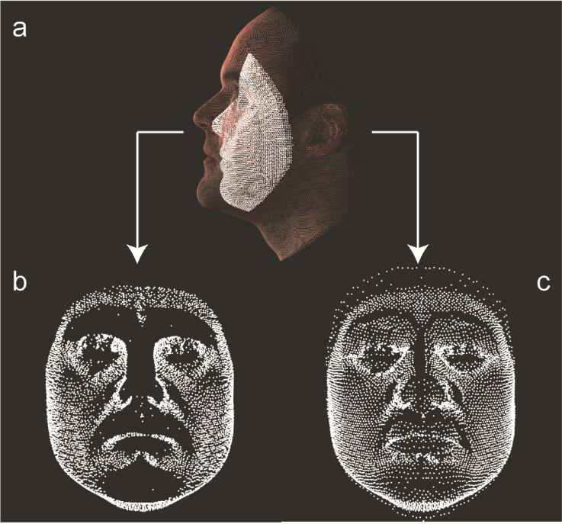
Non-rigid mapping
Deformation to corresponding points (as per part 2, ex 2) b) symmetrical correspondences = true; c) symmetrical correspondeces = false.

Slide 57
Non-rigid Mapping
Outlier Detection/Flagging
ShapeMapper.InlierKappa – set this very high. Effectively you want this outlier detection to be turned off in the non-rigid step otherwise outlier regions may not be deformed towards the target. In future we will allow you to actually turn it off entirely.
ShapeMapper.FlagTargetBoundary and ShapeMapper.FlagFloatingBoundary should be true if the mesh has a ‘boundary’ (is open).

Slide 58
Non-rigid Mapping
Target Upsampling
If the target mesh is very sparse or uneven it is a good idea to upsample it to create a denser, more regular mesh.
You can do this by setting
ShapeMapper.UpSampleTarget = true
ShapeMapper.UpSampleMode = we recommend ‘size’ to ensure the mesh actually ends up regular.
ShapeMapper.UpSampleVal = 1.5; will depend on the size of the structure and the units in which its co-ordinates in which it is coded.

Slide 59
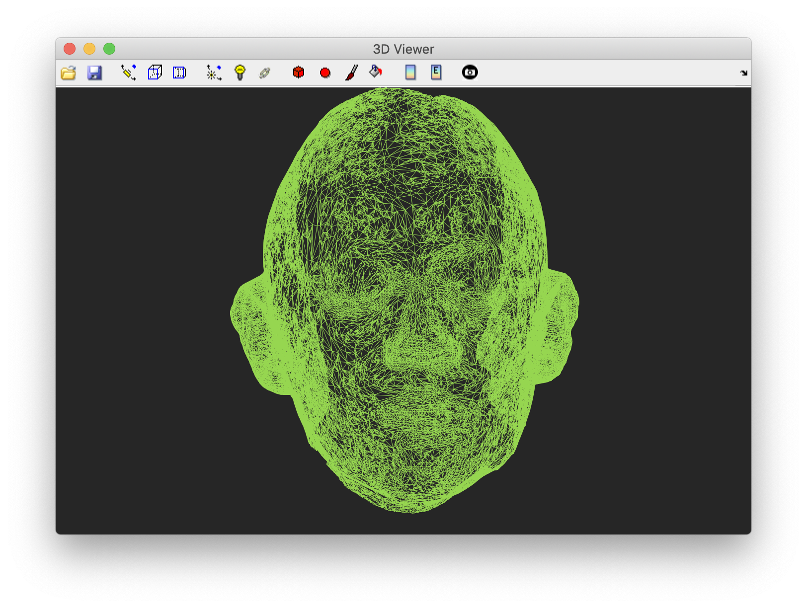
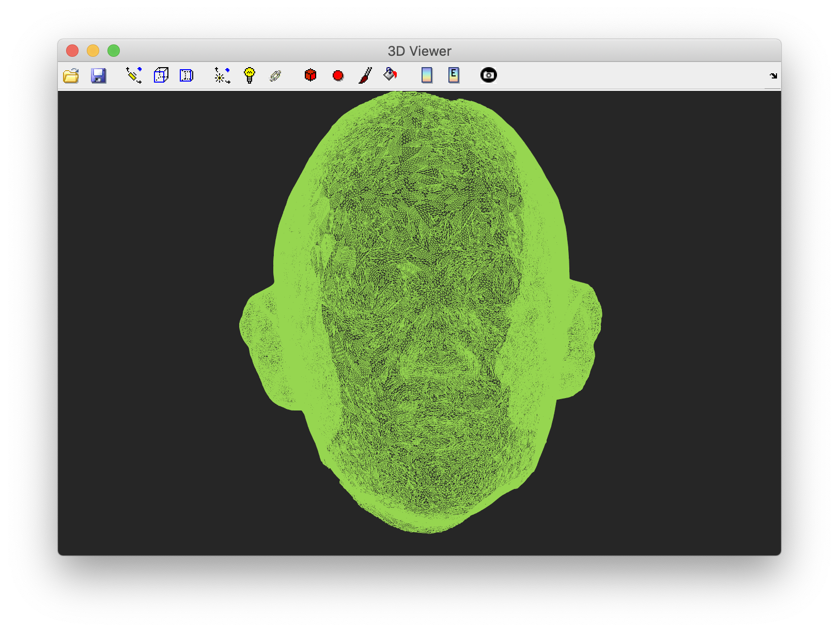
Non-rigid Mapping

Slide 60
Part Five: Tutorial – Exploring Shape Variation with Principal Components Analysis and Partial Least-squares Regression

Slide 61
Practicalities
Open ‘ShapeStatistics.m’
This tutorial uses synthesized (i.e. not belonging to any real person) faces and metadata.
Note that all these faces are in correspondence (as though they were real faces that had been mapped with the template face).
They are composed of the same numbers of points and the same number point is in the same anatomical location in all cases.
This is required for any sort of multivariate analysis of point co-ordinates.

Slide 62
Exercise 1: Generalized Procrustes Analysis
Essentially a technique for centering shapes onto their mean, adjusting for differences in rotation, location and (optionally) size.
Run the cells:
Load all faces
GeneralizedProcrustesAnalysis
Visualise some faces

Slide 63
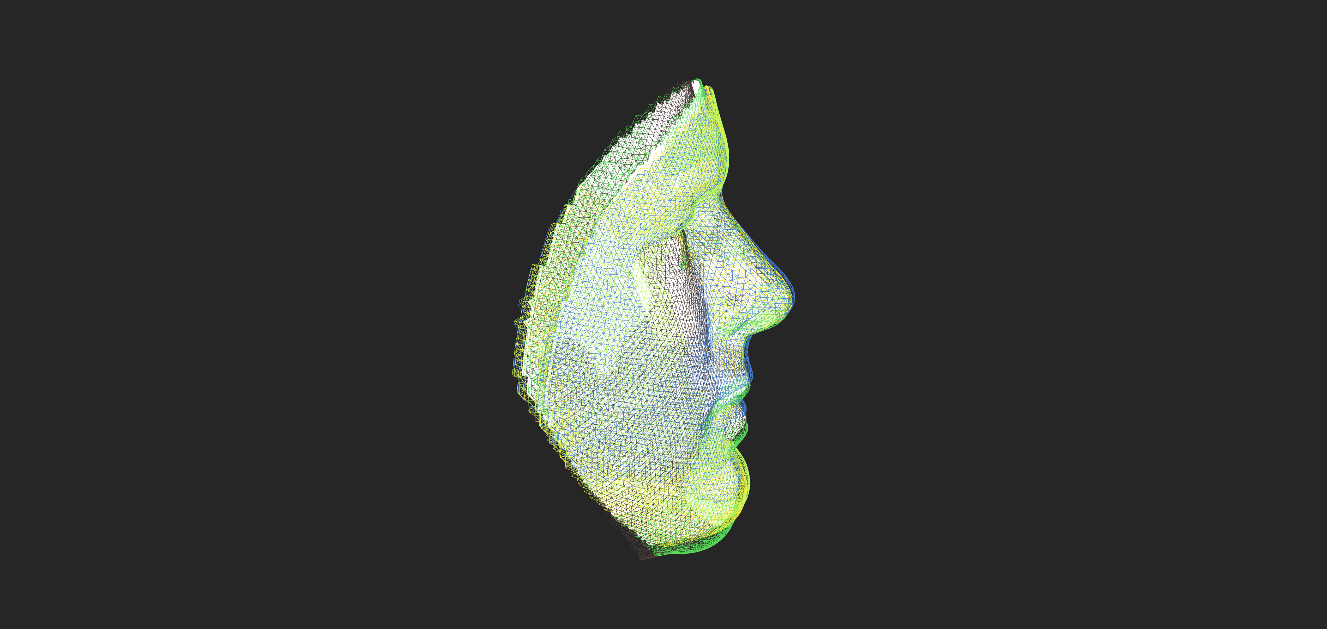
Exercise 1: Generalized Procrustes Analysis
Shows five individuals (each plotted as a wireframe, your colors may not be the same as in the picture) aligned to sample mean face (white).

Slide 64
What is PCA
A low(er) dimensional representation of the variation present among the shapes.
Learns (n-1) PCs required to fully represent all faces in the training data.
A succinct way to represent and to explore variation that is present.
Next two exercise address what a PC is and in what sense they can be said to represent shapes.

Slide 65
Exercise 2: What is a Principal Component?
Each principal component corresponds to a particular linear transformation of facial shape.
A weight on each co-ordinate which can be visualized as:
a field of 3D vectors at each point on the face.
a color-map where each point is indexed to the length/direction of the vector.
a ‘morph’ where the average face is transformed along the vectors.

Slide 66
Exercise 2: What is a Principal Component?
Run the cells:
Plot principal component as a vector field.
Plot principal component as a color-map.
Visualise principal component by transforming average face

Slide 67
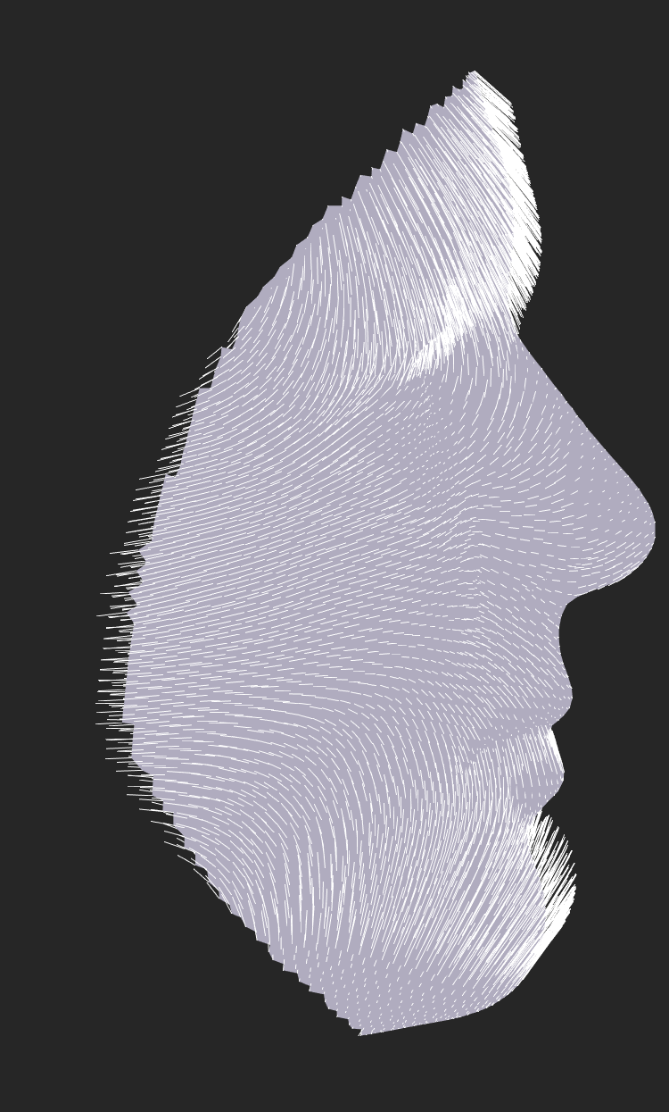
Exercise 2: What is a Principal Component?

Slide 68
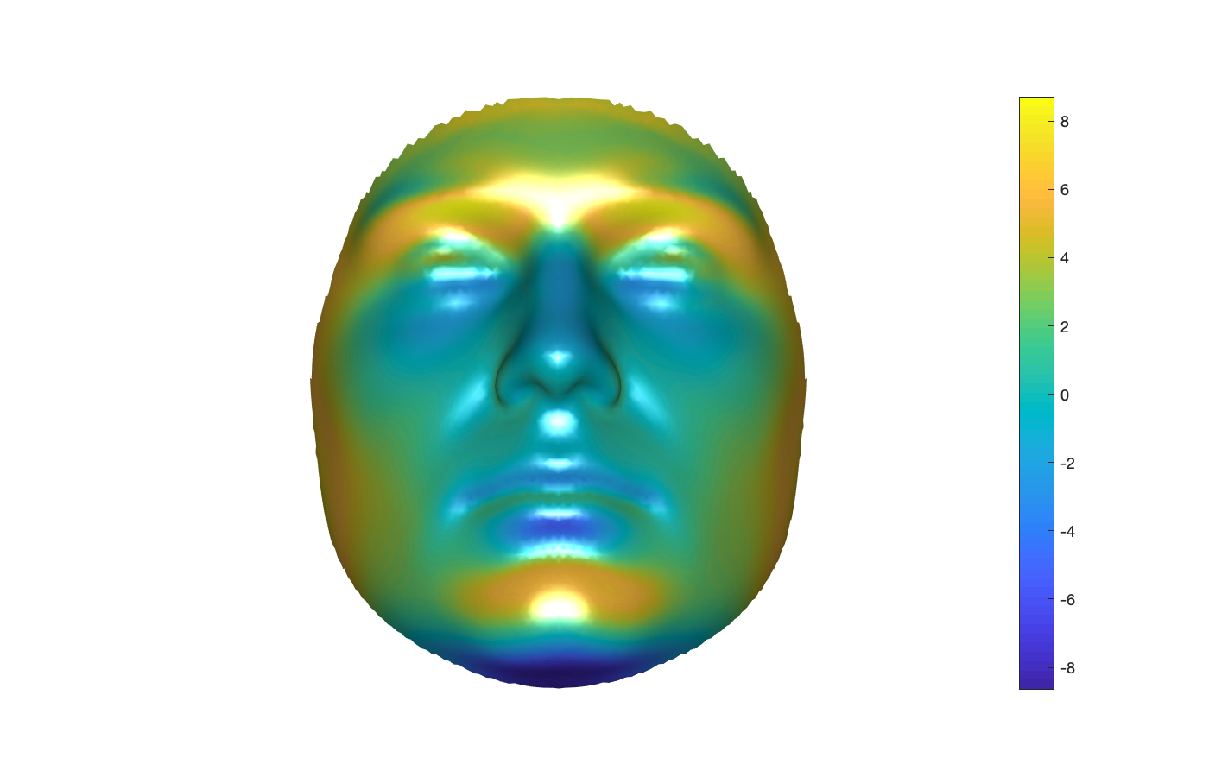
Exercise 2: What is a Principal Component?

Slide 69
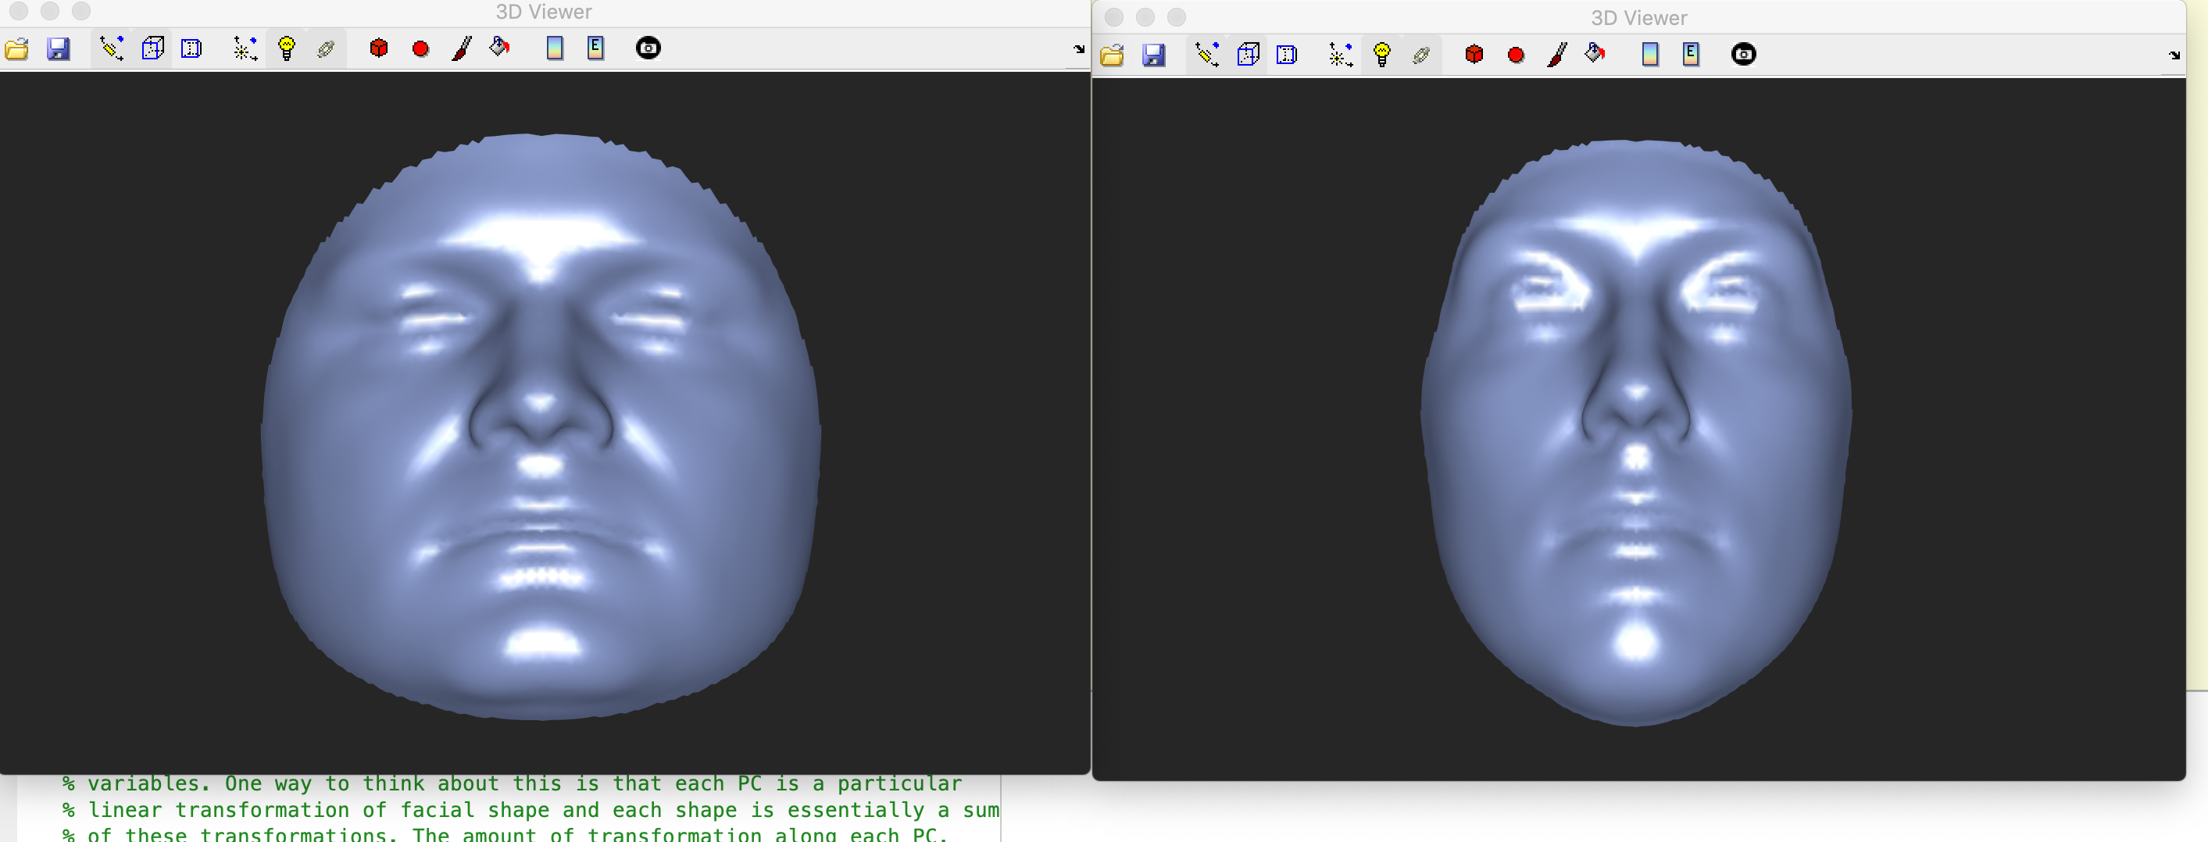
Exercise 2: What is a Principal Component?

Slide 70
Exercise 3: How do PC ‘Scores’ Represent a Shape
The vector of PC ‘scores’ for an individual are a recoding of that individual’s shape on a smaller number of variables.
A PC is a particular linear transformation of shape.
An individual shape can be represented as a sum of different linear transformations.
The magnitude of the transformation required (along each PC) to reconstruct the individual is coded in their ‘scores’.

Slide 71
Exercise 3: How do PC ‘Scores’ Represent a Shape
Run the cell:
Relationship between PC scores and the original shapes.
This gradually reconstructs the given shape by successively adding the transformations modelled by each PC (scaled by the individual’s score)
You will need to press any key in the terminal to add each PC.

Slide 72
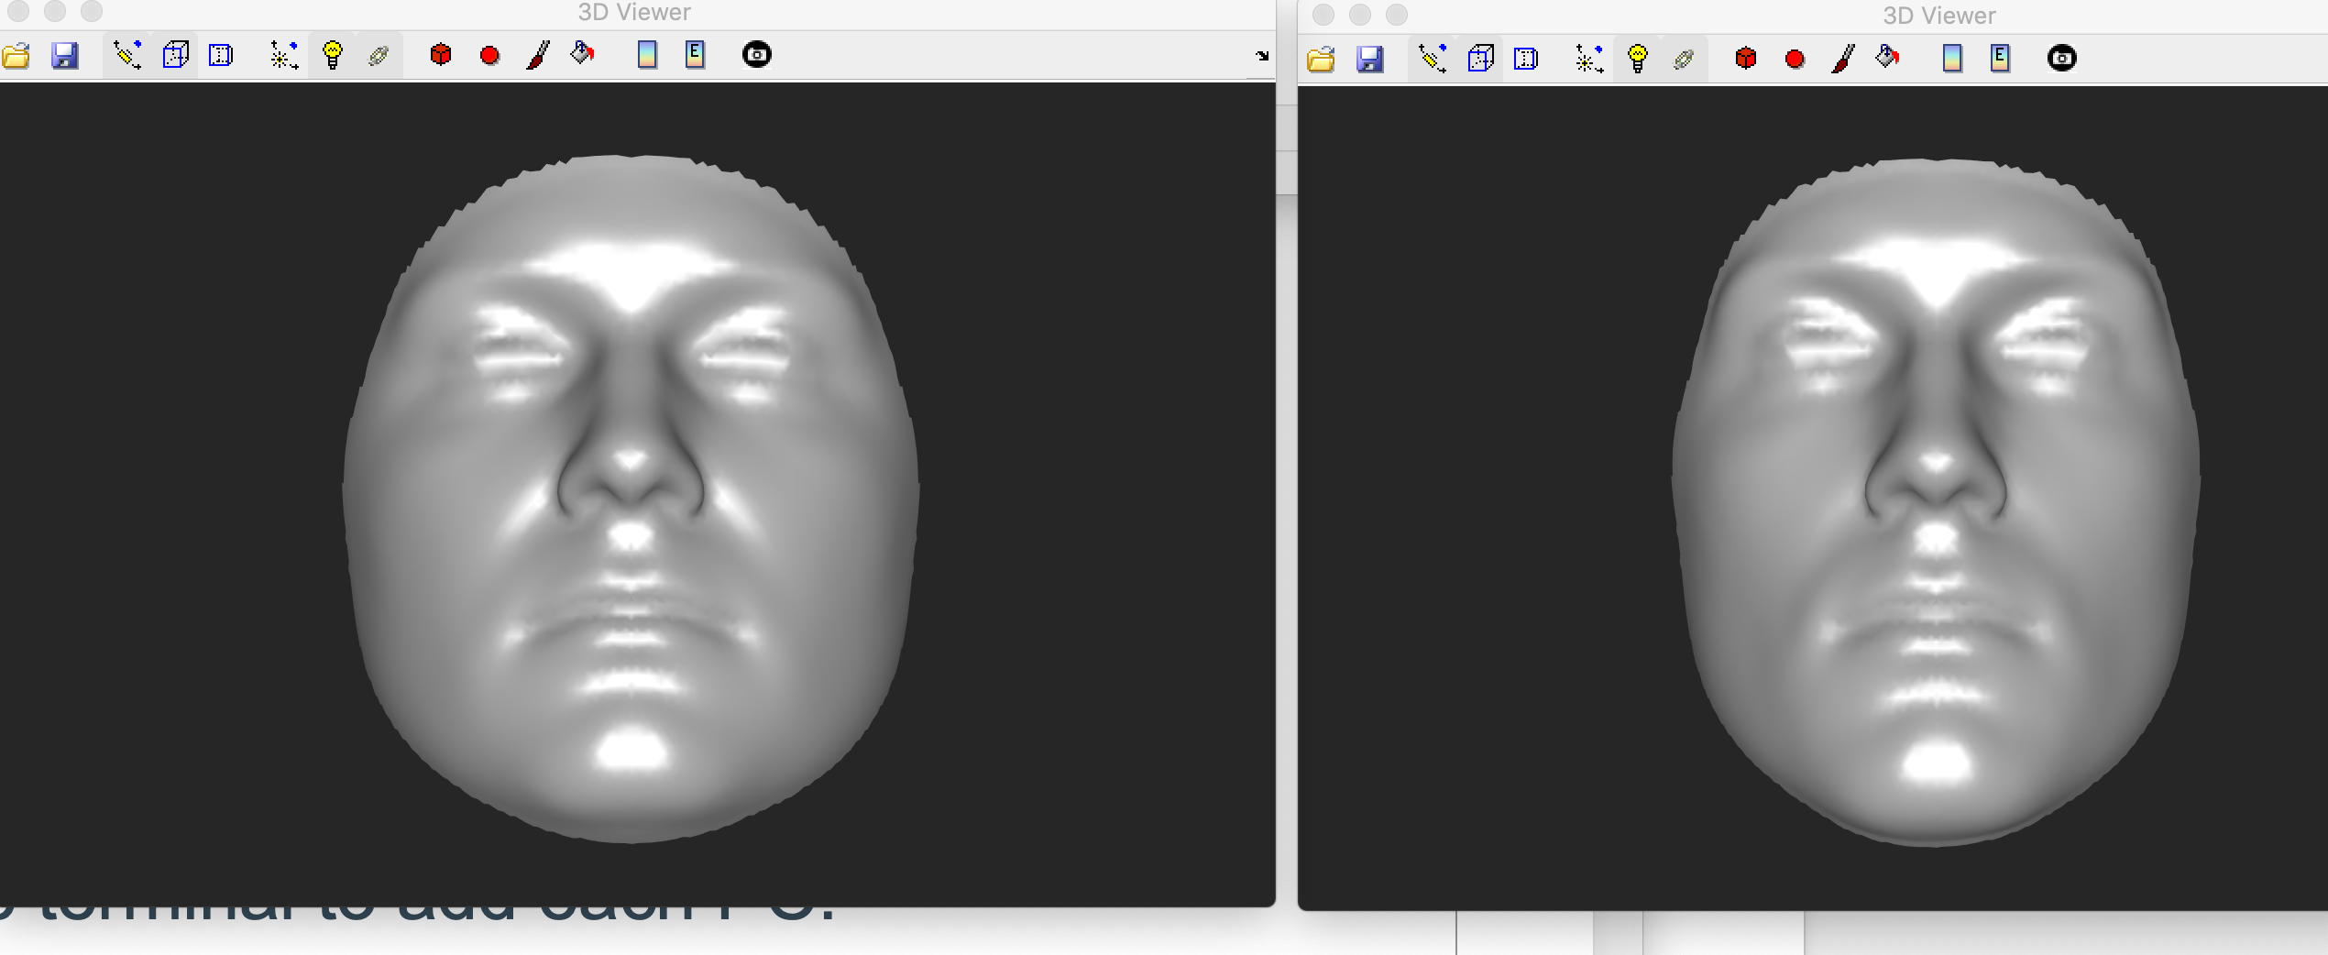
Exercise 3: How do PC ‘Scores’ Represent a Shape
Average
Original Face

Slide 73
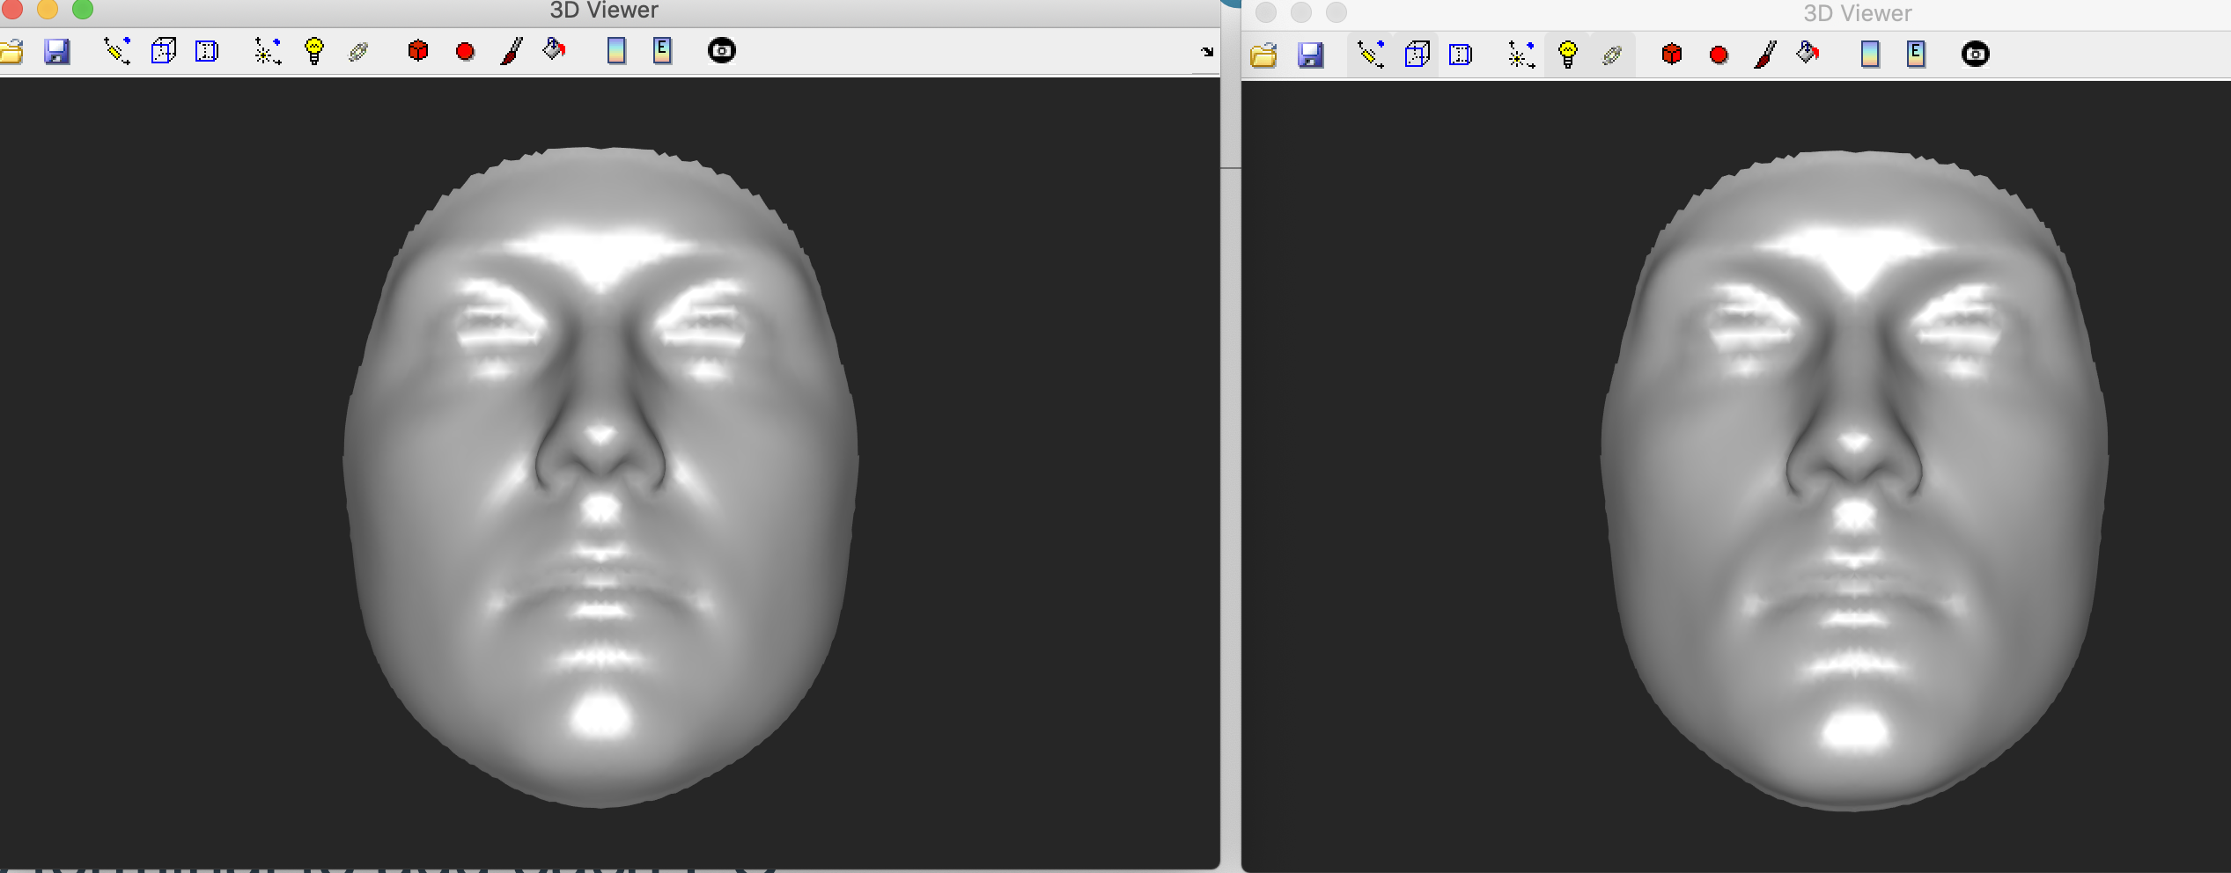
Exercise 3: How do PC ‘Scores’ Represent a Shape
Average + PC1
Original Face

Slide 74
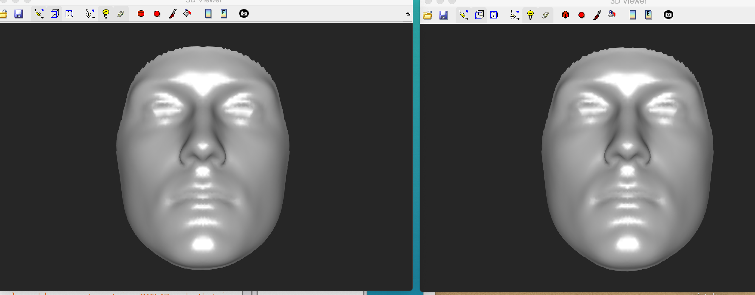
Exercise 3: How do PC ‘Scores’ Represent a Shape
Average + PC1 + PC2
Original Face

Slide 75
Exercise 4: PC Score Plots
The vector of scores for an individual represent their shape, providing a low-dimensional recoding of the high-dimensional shape.
In general we want to make some inference about the realationship between a variable and the shape.
A small number of scores (e.g. 2 or 3) MAY, under some circumstances represent individual shapes (and therefore variation among them) well enough to justify creating a bi- or tri-plot of PC scores to visualize the distribution of groups/variables within the space.

Slide 76
Exercise 4: PC Score Plots
Plot scores on PC1 x scores on PC2, colored according to age, BMI and sex.
Run the cell:
Create PC bi-plots colored according to metadata

Slide 77
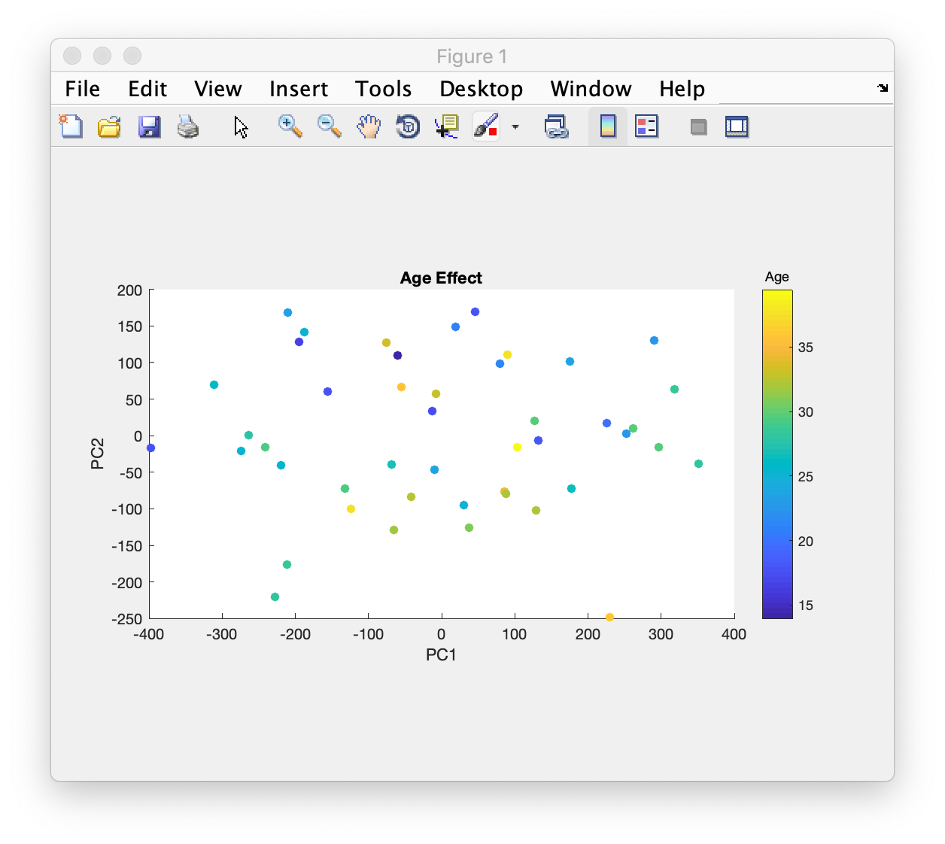
Exercise 4: PC Score Plots

Slide 78
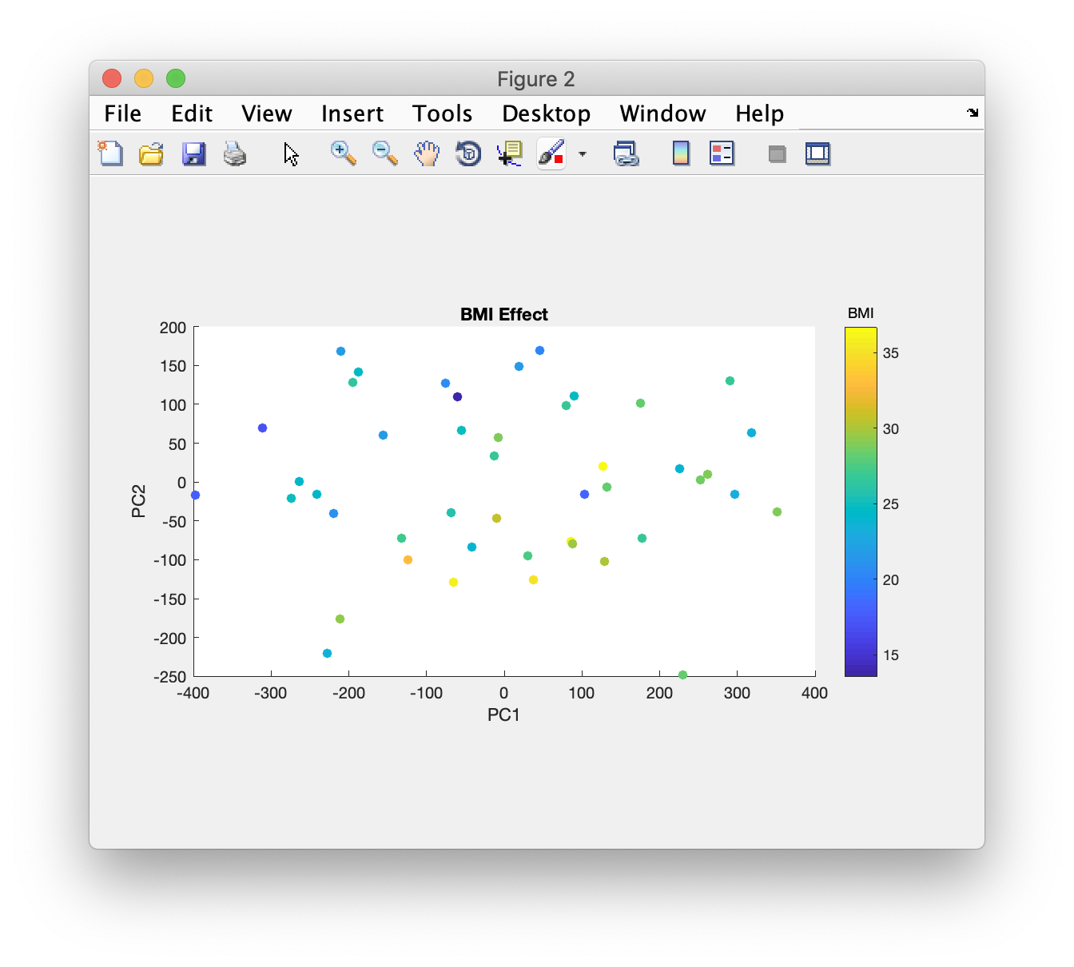
Exercise 4: PC Score Plots

Slide 79
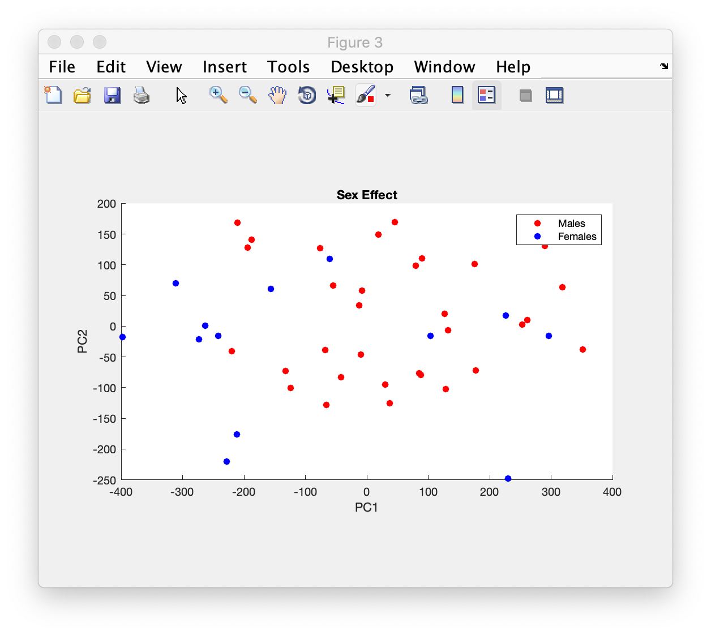
Exercise 4: PC Score Plots

Slide 80
PCA Summary
PCs (scaled by their associated variances) illustrate the type and magnitude of variation that exists within a given dataset.
A small number of scores may represent quite a lot of the variation among shapes.
But score plots are limited:
Only represent some of the variation. May not necessarily be the aspects that are affected by a given variable.
How to know what the effect of a variable is on the shape?
General approach is to reverse-engineer from PC scores
Find what PCs are significantly associated with the variable
Look at the PC transformations.
But an effect could load on many PCs
Individually these may be non-significant but together the effect could be substantial.
Difficult to mentally combine multiple PC transformations

Slide 81
Exercise 5: PLS Score Plots
Partial least-squares regression is:
A supervised dimension reduction of X (predictor variables) and Y (shape) onto a small number of dimensions
Like PCA of shape except the subspace is optimized to be linearly associated with X.
Run the cell:
plot PLS Yscores
A good reference about PLS in general:
Geladi and Kowalski (1986) https://doi.org/10.1016/0003-2670(86)80028-9
Some various applications in shape analysis specifically:
Rholf and Corti (2000) https://doi.org/10.1080/106351500750049806
Shrimpton et al (2014) https://doi.org/10.1016/j.forsciint.2013.10.021
Young et al. (2016) https://doi.org/10.1016/j.ajodo.2015.09.028

Slide 82
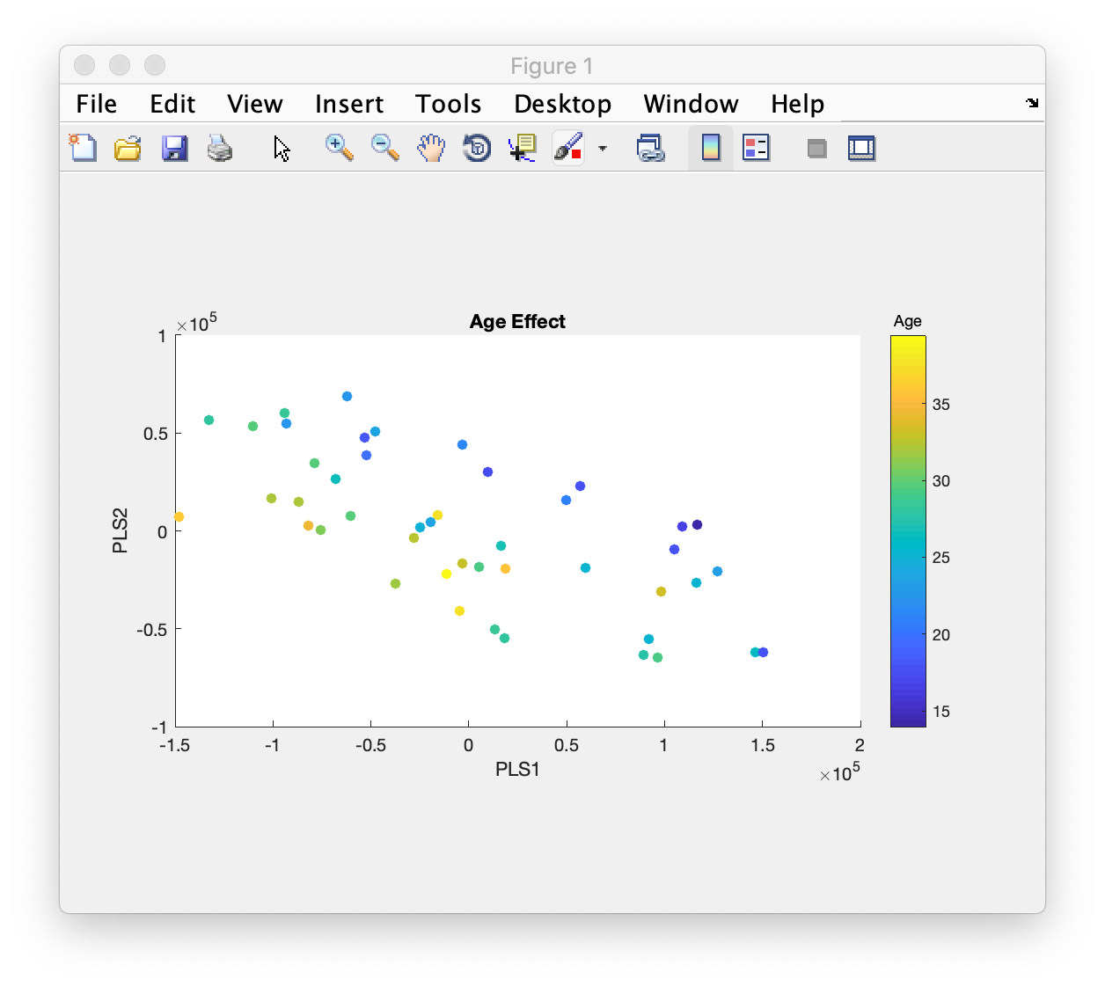
Exercise 5: PLS Score Plots
PCA
PLS

Slide 83

Exercise 5: PLS Score Plots
PCA
PLS

Slide 84
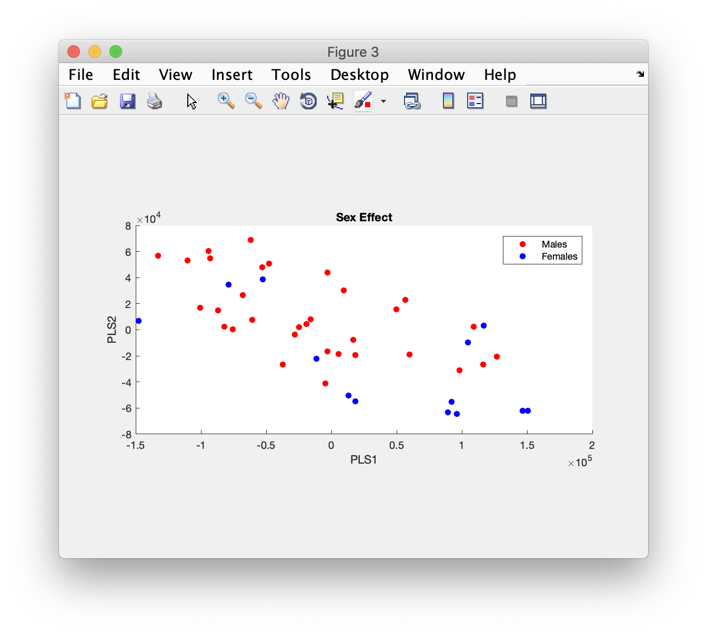
Exercise 5: PLS Score Plots
PCA
PLS

Slide 85
Exercise 5: PLS Score Plots
Partial least-squares regression is:
A supervised dimension reduction of X (predictor variables) and Y (shape) onto a small number of dimensions
Like PCA of shape except the subspace is optimized to be linearly associated with X.
So scores are necessarily associated with the predictors (they change in a graduated way from one extreme of the space to another)
These plots are also problematic to interpret
Over-fitted: given enough shape variables there will always exist some subspace that is associated with the variables, but may be modelling noise.
Cross-validation to determine ‘real’ components.
How to infer effect of variable on shape still difficult.

Slide 86
Exercise 6: PLS Regression Coefficients
Partial least-squares regression is:
A supervised dimension reduction of X (predictor variables) and Y (shape) onto a small number of dimensions.
A multivariate regression of the reduction of Y (the PLS Scores we just saw) onto the reduction of X (which we didn’t).
This regression is then expressed in terms of the original variables (the landmark co-ordinates).
The prior dimension reduction into a small number of uncorrelated variables allows for regression of high-dimensional, highly correlated variables.

Slide 87
Exercise 6: PLS Regression Coefficients
In MATLAB plsregress ‘BETA’ output argument contains the regression coefficients.
First row of BETA is the model intercept, the second row contains the regression coefficients for the first variable in x and so on.
Regression coefficients are weights on each landmark and can be visualized in the same ways as PCs.
Run the cell:
‘Visualise independent effects of age, BMI and Sex on the face’

Slide 88
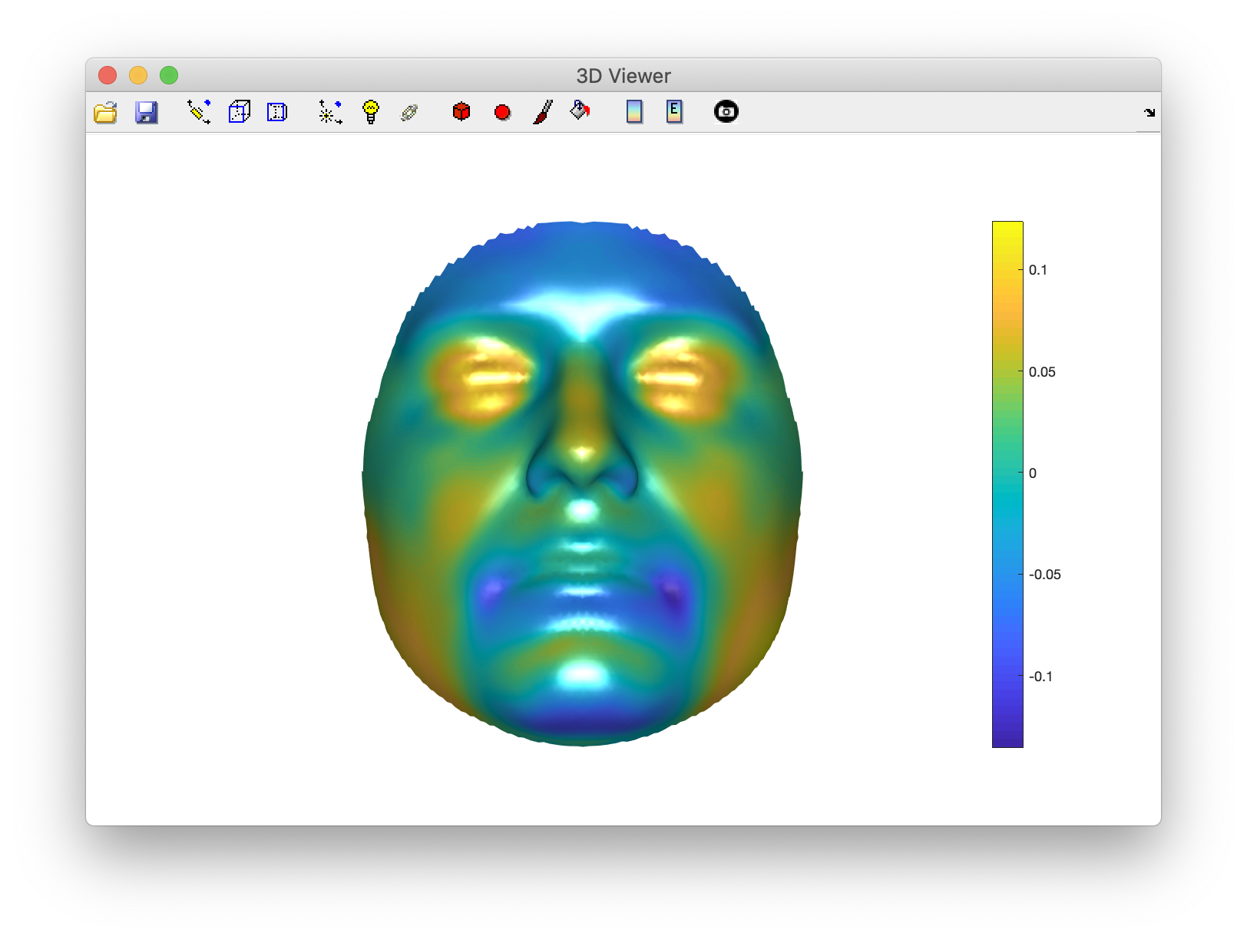
Exercise 6: PLS Regression Coefficients
Younger -> older

Slide 89
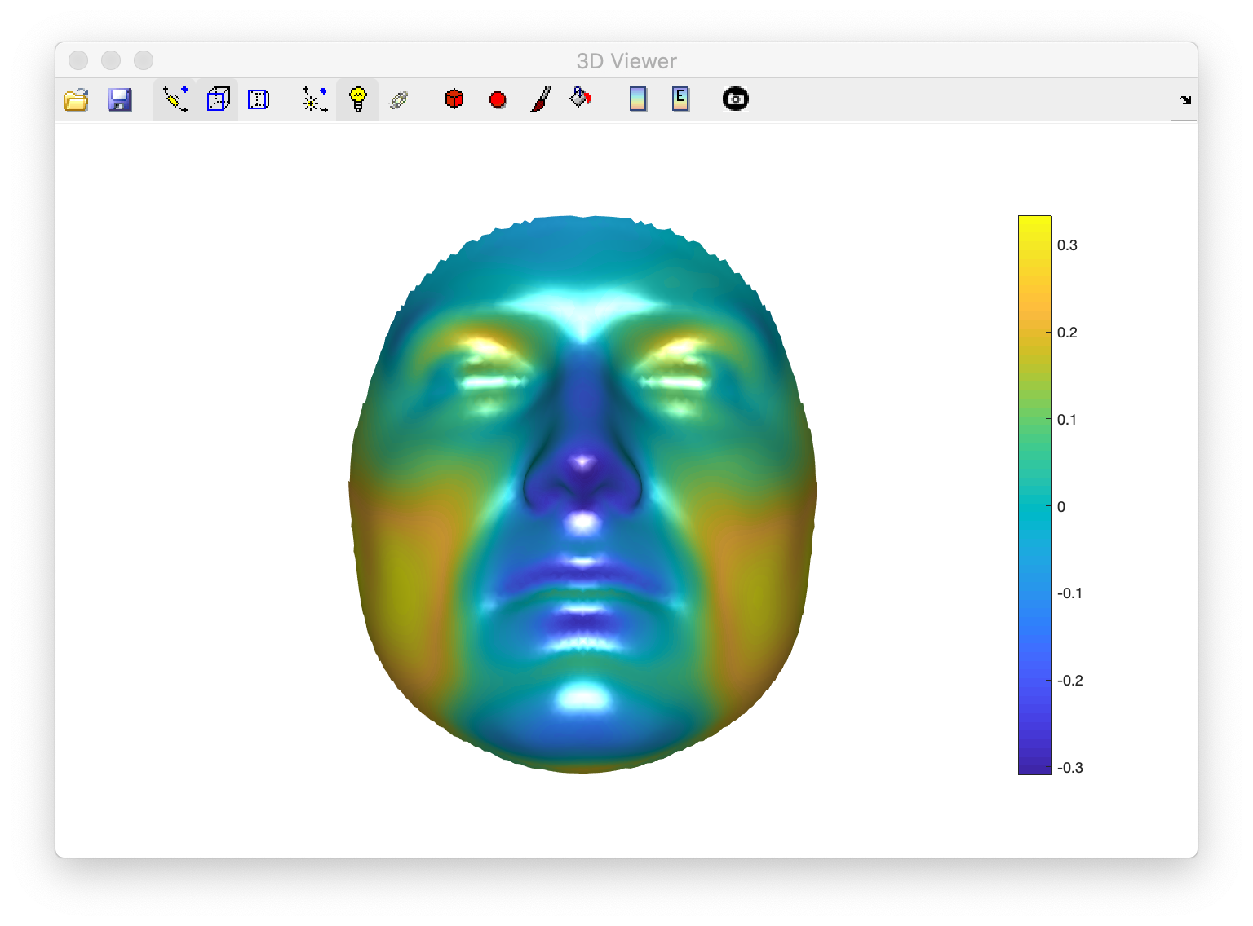
Exercise 6: PLS Regression Coefficients
low BMI-> high BMI

Slide 90
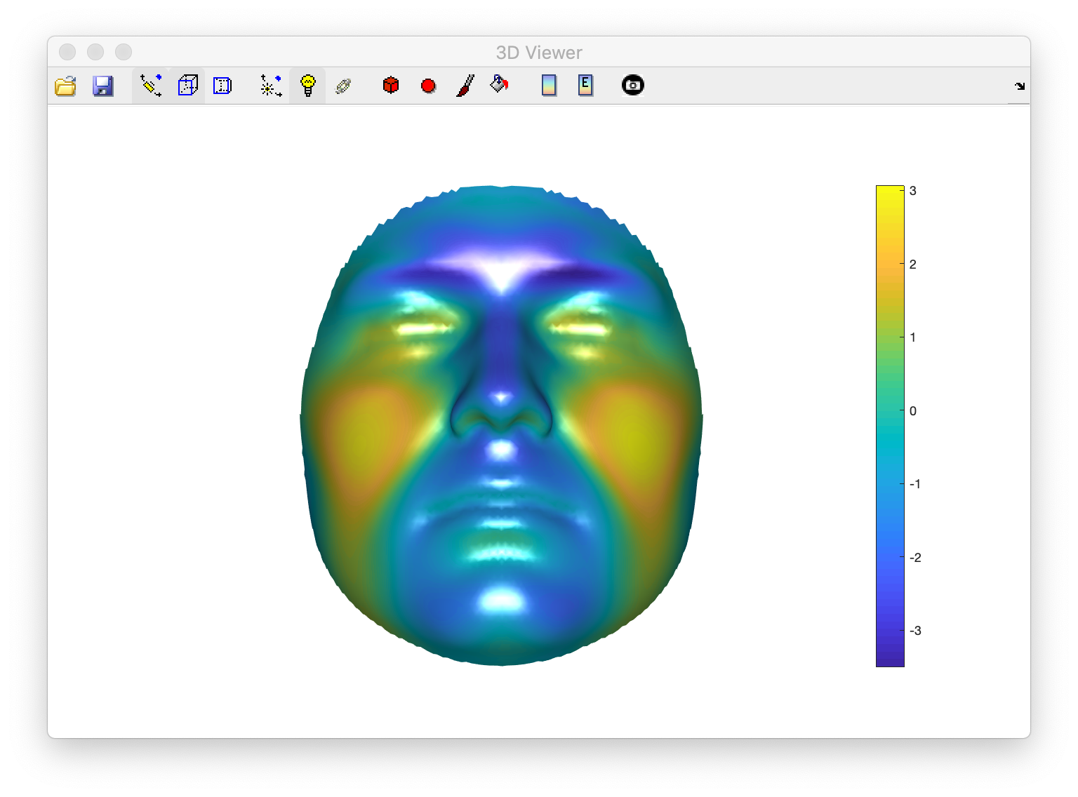
Exercise 6: PLS Regression Coefficients
Male -> Female

Slide 91
Exercise 7: PLS Significance Testing
PLSR was not developed initially for statistical hypothesis testing for effects of individual predictor variables on the outcome.
No test statistic and parametric sampling distribution thereof was ever derived.
cf the related method Canonical Correlation Analysis which does give a parametric p-value.
Permutation test on partial Rsquared:
Shrimpton et al. (2014) https://doi.org/10.1016/j.forsciint.2013.10.021
Andresen and Legendre (1999) https://doi.org/10.1080/00949659908811936

Slide 92
Exercise 7: PLS Significance Testing
Run the cell: Permutation test on partial R-squared
Change varnum (at top of cell) to values 1, 2 and 3 to run the test again for each variable

Slide 93
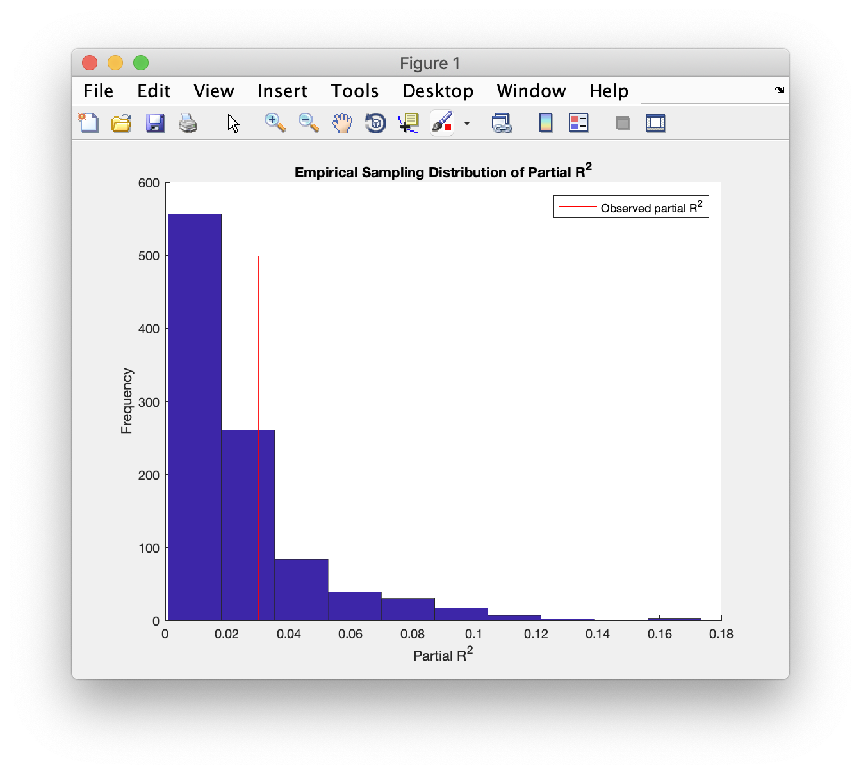
Exercise 7: PLS Significance Testing
Varnum = 1 (Age)
p = .237

Slide 94
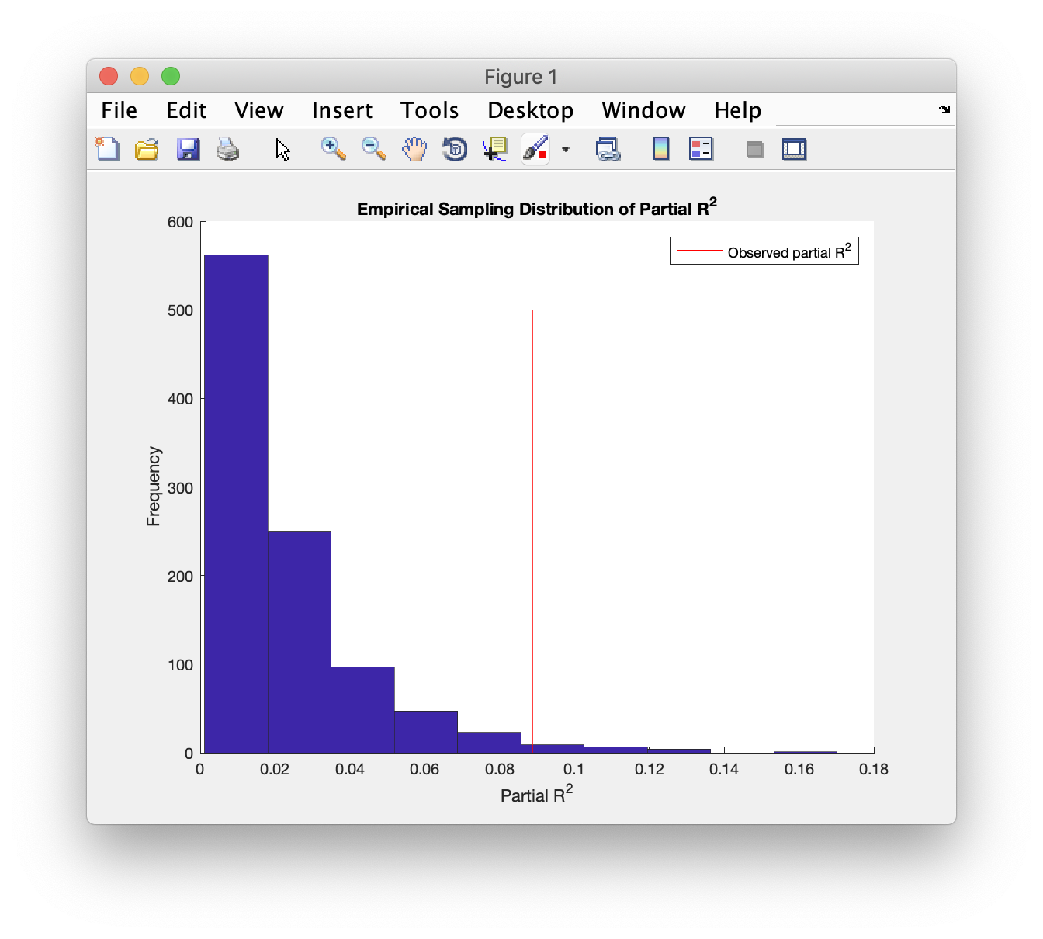
Exercise 7: PLS Significance Testing
Varnum = 2 (BMI)
p = .018

Slide 95
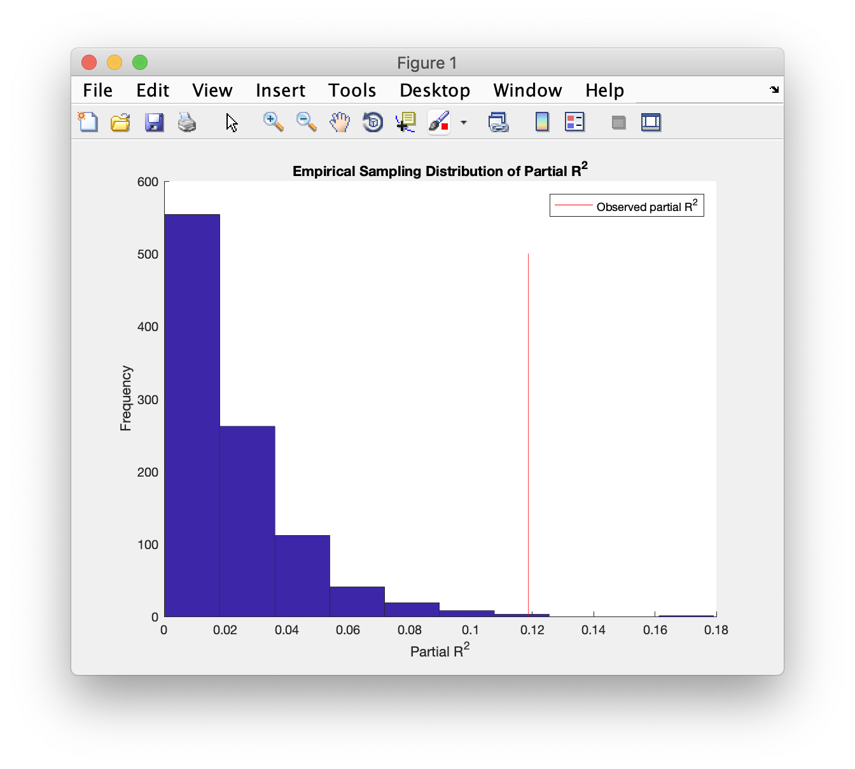
Exercise 7: PLS Significance Testing
Varnum = 3 (Sex)
p = .001

